Slide 1
Advanced Treatment Options for Severe COPD: A Review of Bronchoscopic Lung Volume Reduction (BLVR)
Ajay Wagh, MD
Living Better Together COPD Conference
Nov 14, 2024

Slide 2
Disclosures
None Related to this Topic
Consultant
  Noah
  Medtronic
  Ambu
  Cook
  Biodesix

Slide 3
Objectives
Brief overview of COPD
Severe Emphysema & Hyperinflation
Rationale for BLVR
BLVR Procedural Expectations BLVR Evaluation, Procedure, Post procedure
Conclusions

Slide 4
A Brief Overview of COPD

Slide 5
What is COPD?
A common, preventable, and treatable disease that is characterized by persistent respiratory symptoms and airflow limitation.
Risk factors:
  Tobacco smoking
  Other environmental exposures
    Biomass fuel exposure
    Air Pollution
  Host factors
    genetic abnormalities
    abnormal lung development
    accelerated aging
www.goldcopd.org

Slide 6
Pathways to the Diagnosis of COPD
Symptoms
  Dyspnea
  Chronic Cough
  Sputum
Risk Factors
  Host Factors
  Tobacco
  Occupation
  Indoor/Outdoor Pollution
Spirometry
  Required for the Diagnosis
www.goldcopd.org

Slide 7
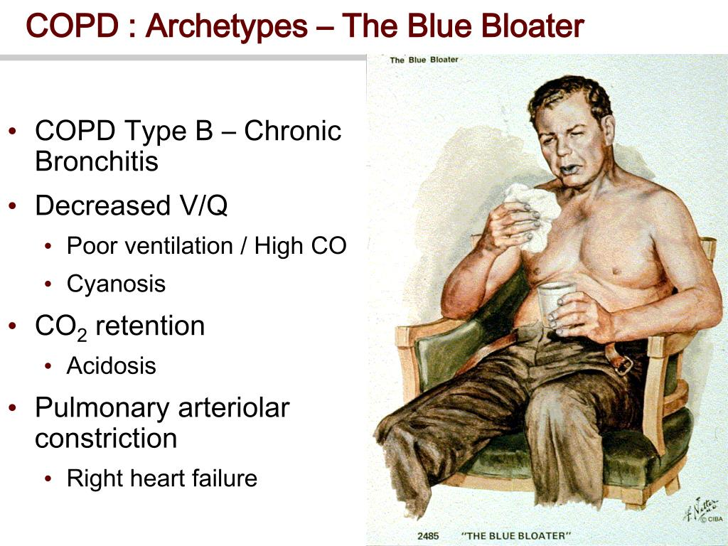
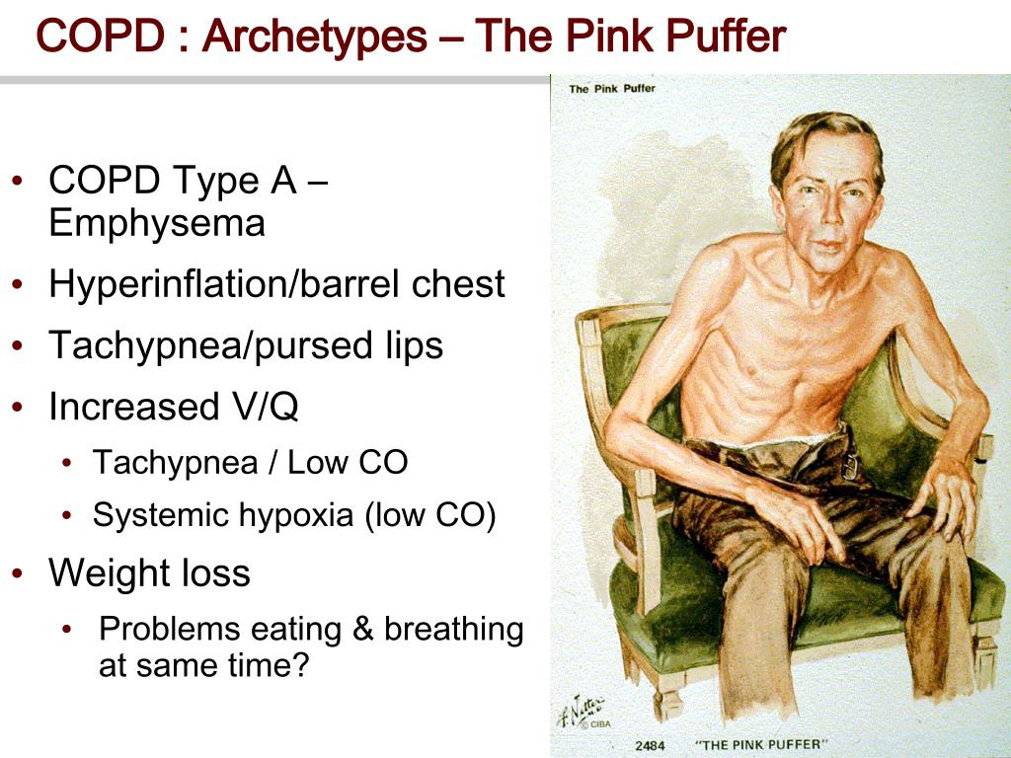
COPD Phenotypes
Frank Netter Atlas of Anatomy

Slide 8
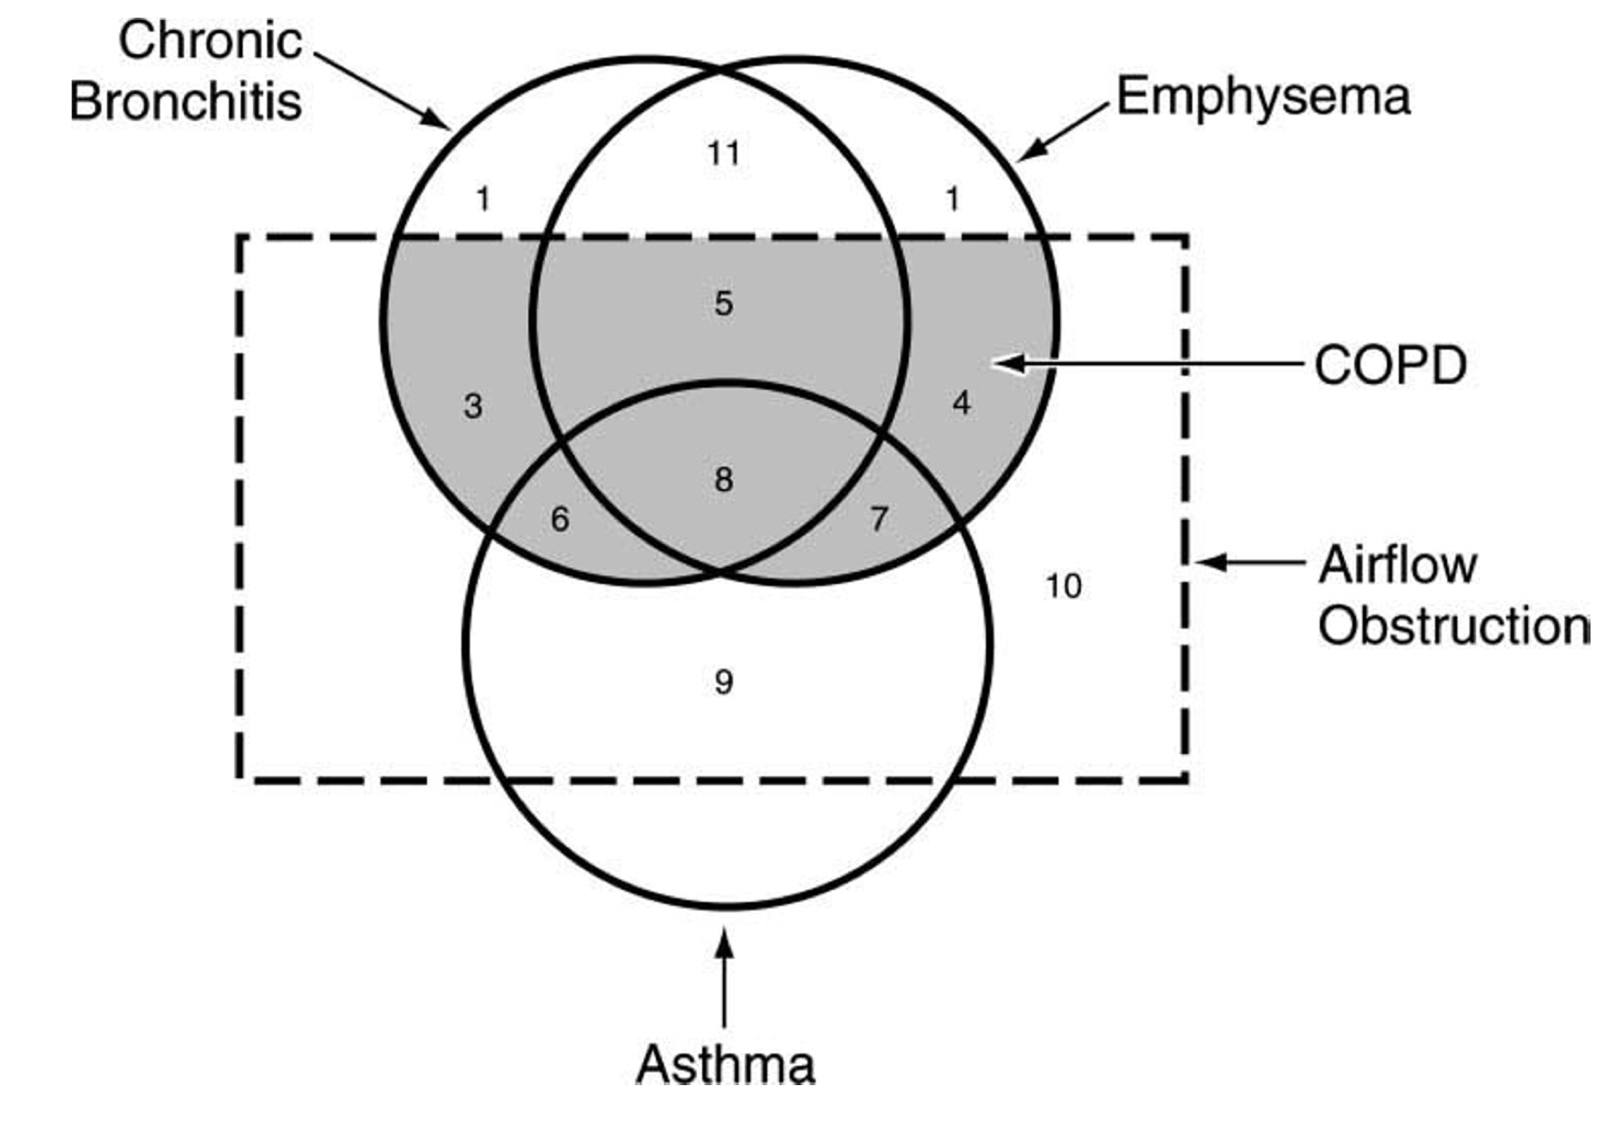
The COPD/Asthma Venn Diagram - Overlap
Reversible airflow obstruction

Slide 9
Classification of Airflow Limitation Severity in COPD
GOLD 1: Mild FEV1 ≥ 80% Predicted
GOLD 2: Moderate 50% ≤ FEV1 < 80% Predicted
GOLD 3: Severe 30% ≤ FEV1 <50% Predicted
GOLD 4: Very Severe FEV1<30% Predicted
www.goldcopd.org

Slide 10
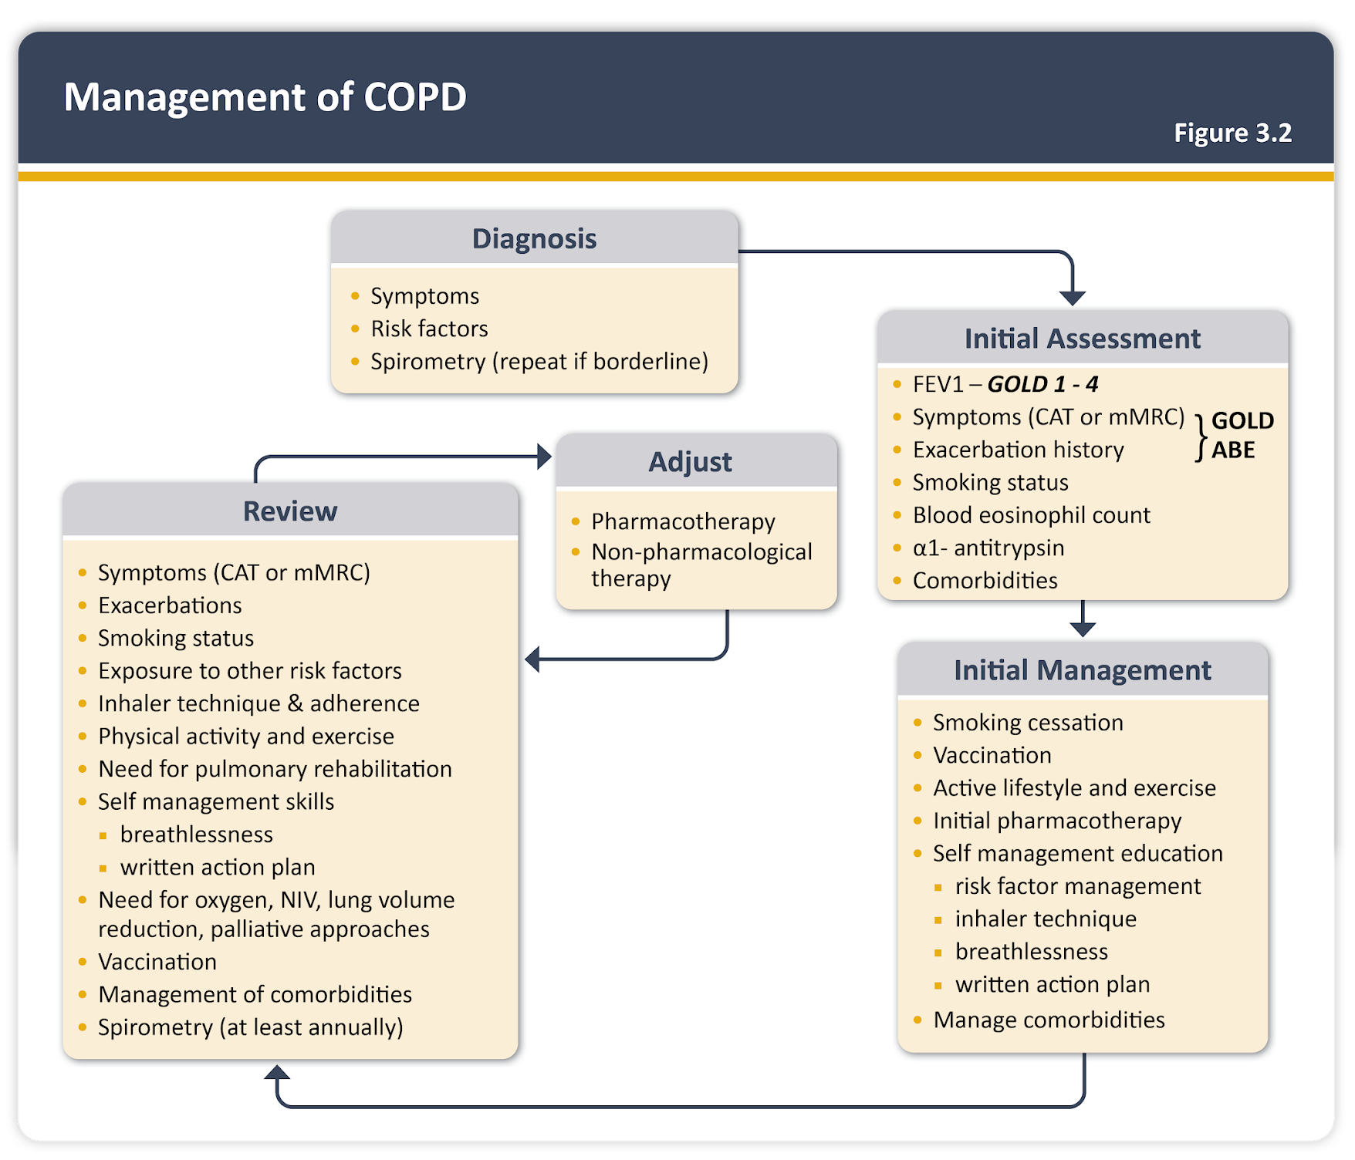
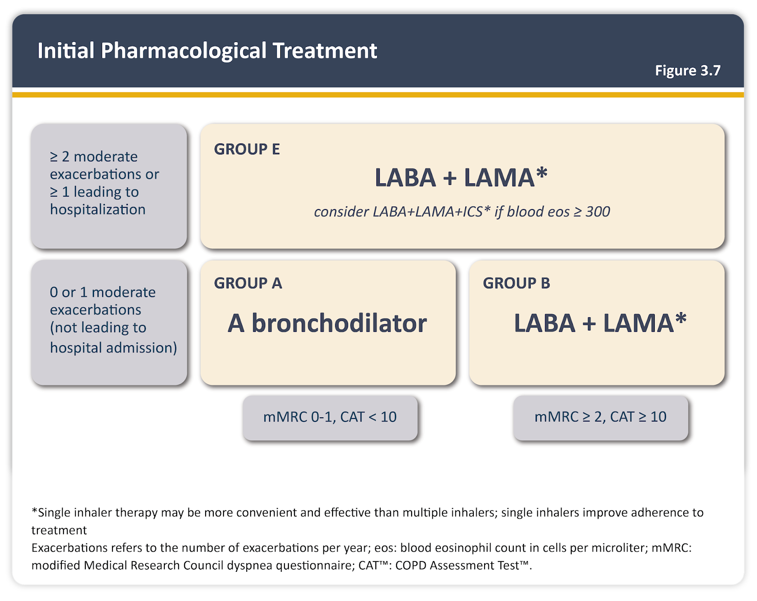
General Treatment Algorithm for COPD
www.goldcopd.org

Slide 11
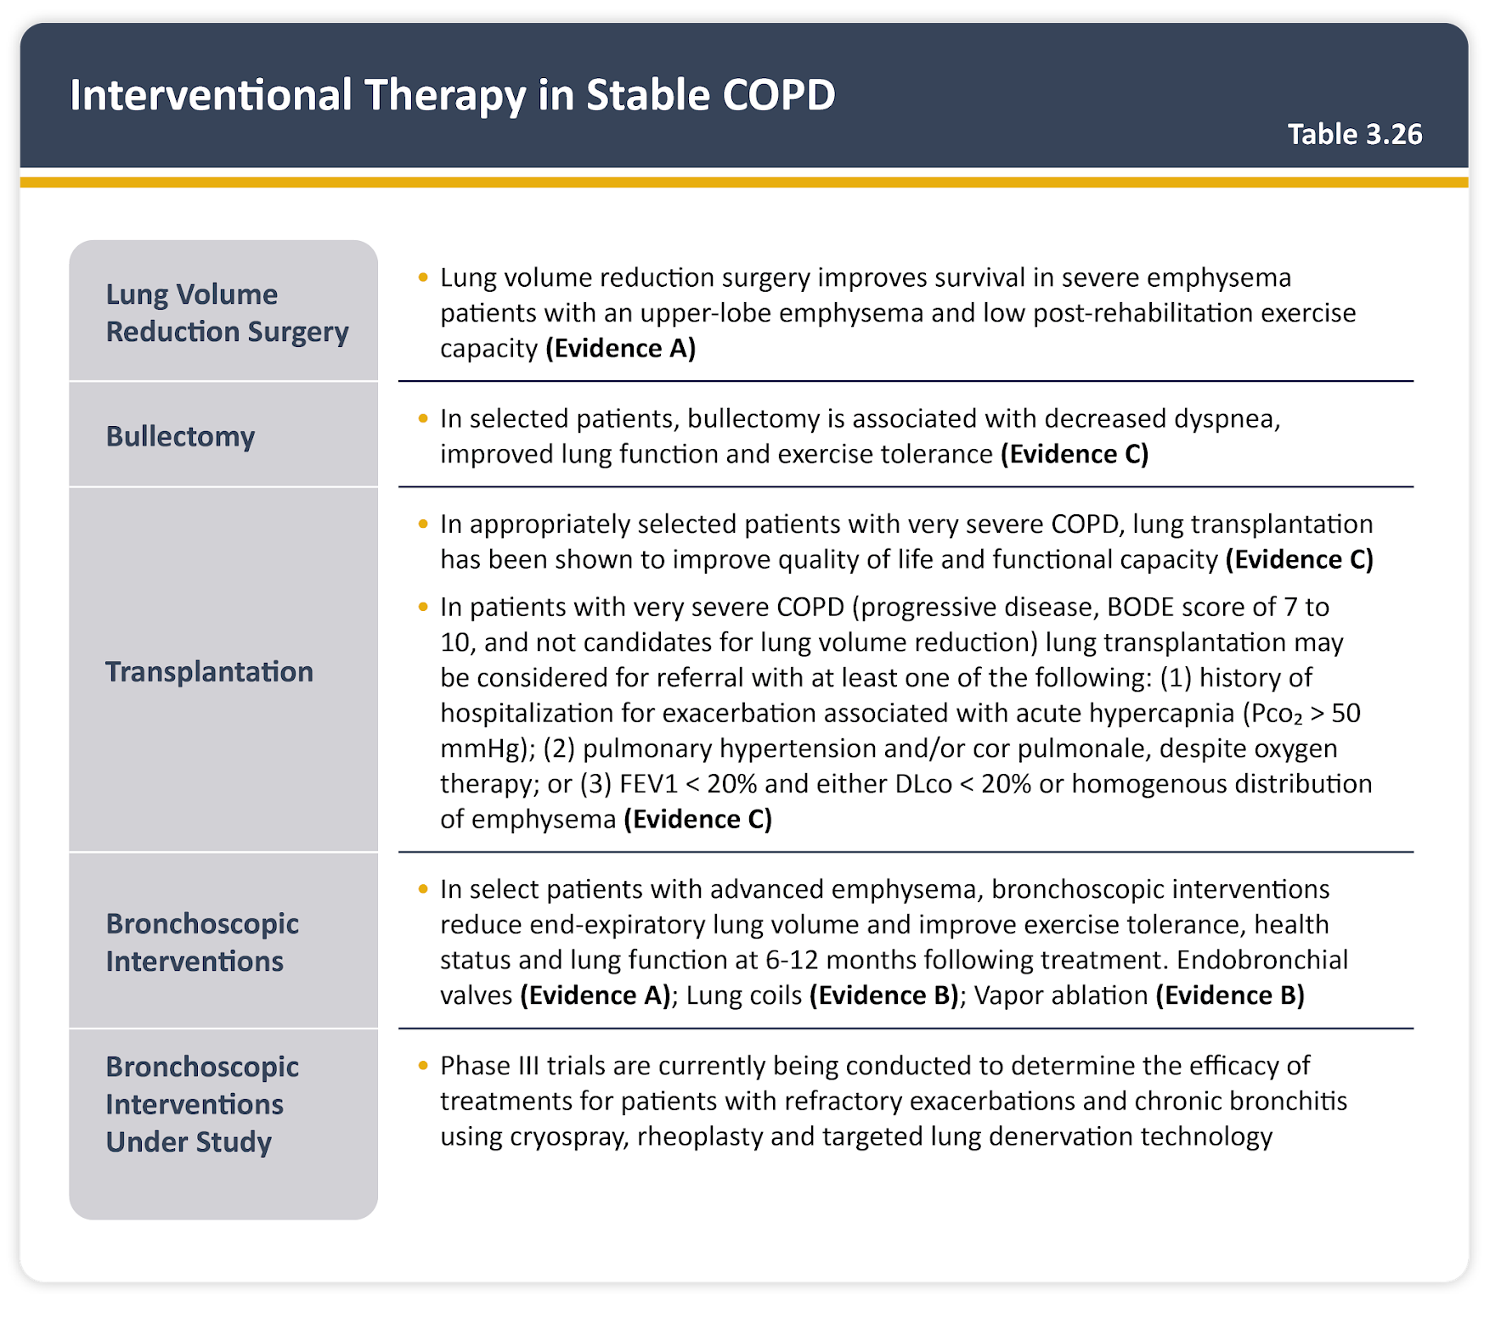
Interventional Therapies
www.goldcopd.org

Slide 12
My General Initial COPD Approach
H&P and Spirometric Evaluation
Smoking Cessation Counseling
Supplemental O2 evaluation
Inhalers/Bronchodilators
Vaccination/Prevention
Pulmonary Rehab
Lung Cancer Screening
BLVR or Transplant evaluation?

Slide 13
Emphysema and Hyperinflation
&
Rationale for BLVR

Slide 14
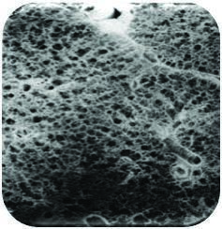
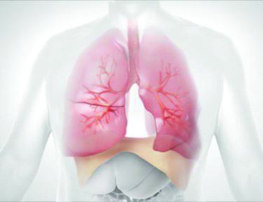
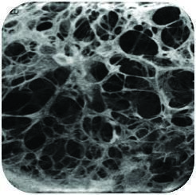
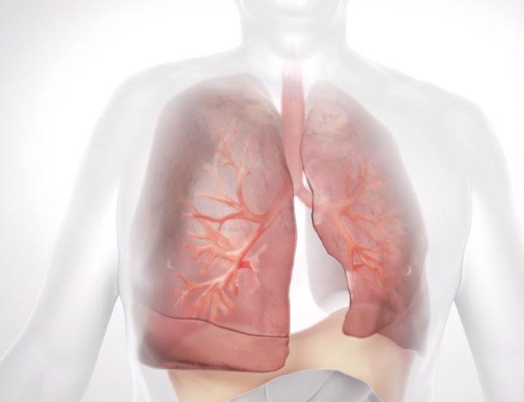
Air Trapping and Hyperinflation in Emphysema
Healthy Lung
Tissue is elastic with large surface area
Breathing is easy; lung expands and contracts normally
Lung with Emphysema
Tissue destruction reduces elasticity and gas exchange
Air is trapped in the diseased portion of the lungs, increasing lung volume and putting pressure on the diaphragm, making patient persistently breathless
Notes:
Discuss damage and highlight image with hyperinflation

Slide 15

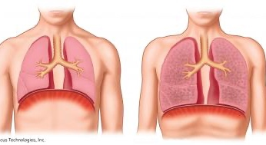
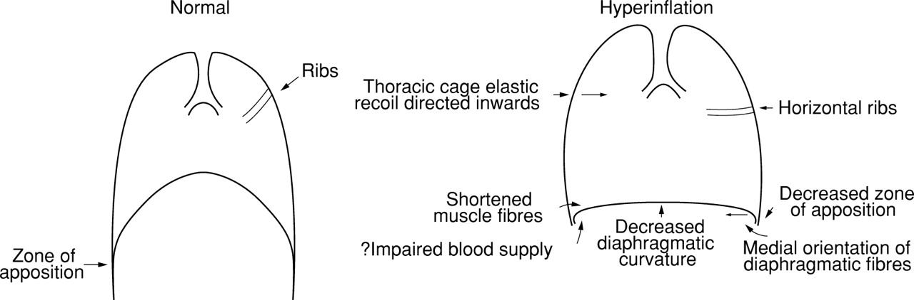
Hyperinflation on Respiratory Muscle Function
Summary of detrimental effects of hyperinflation
on respiratory muscle function.
N M Siafakas et al. Thorax 1999;54:458-465
Copyright © BMJ Publishing Group Ltd & British Thoracic Society. All rights reserved.
US-EN-574 v1
Notes:
Summary of detrimental effects of hyperinflation on respiratory muscle function. Modified from Tobin.74

Slide 16
LVRS Treats Hyperinflation (NETT)
Negative Aspects
  Associated mortality
  Pulmonary and cardiac morbidity
  Does not help all patients
  Limited access
  Costly
Benefits
  Improves long-term survival (median follow-up 4.3 years)
  Improves lung function, exercise performance and quality of life
  Decreases frequency of exacerbations
NETT Research Group, NEJM, 2003; Naunheim, Ann Thor Surg 2006; Naunheim, JTCVS, 2006; Criner AJRCCM, 2011
Notes:
Follow up on LVRS

Slide 17
Rationale for BLVR for Patients with Emphysema
Physiological abnormalities (reduced FEV1, gas trapping, hyperinflation, reduced DLCO)
Increasing residual volume (RV) results in hyperinflation leading to:
  Potential for dynamic hyperinflation with exercise
  Reduced circulatory function
  Flattening of diaphragm
  Expansion of thoracic cavity (rib cage)
  Ineffective respiratory effort
  Increased work of breathing
  Dyspnea
Reduce dead space
Improve dynamic compliance/stretch
Improve chest wall mechanics
Improved Cardiac Preload, Contractility, and Output
=Reduced Dyspnea
TREATMENT
Diaz O et al. Eur Resp J. 2000.
O’Donnell DE et al. AJRCCM. 1997.
van der Molen MC et al. AJRCCM. 2022.

Slide 18
Effects of Hyperinflation and Treatment
Reduced Survival with Hyperinflation
Reduction in Hyperinflation can result in improved Cardiac Function in patients with Emphysema.
Ciro Casanova et al. Am J Respir Crit Care Med 2005 171591-597.ew
van der Molen MC, et al. Am J Respir Crit Care Med. 2022 Sep 15;206(6):704-711

Slide 19
Recent Metanalysis Studies
Several recent metanalysis results demonstrate improvement after EBV.
  SGRQ, FEV1, 6MWD, RV
Better Results
  Heterogeneous Emphysema (c/w Homogeneous)
  CV-
Patel M et al. JOBIP. 2022.
Iftikhar I et al. Ann Am Thorac Soc . 2020.
Labarca G et al. Respiration. 2019.
Majid A et al. Respiration. 2020.
Van Geffen W et al. Lancet Respir Med. 2019.

Slide 20
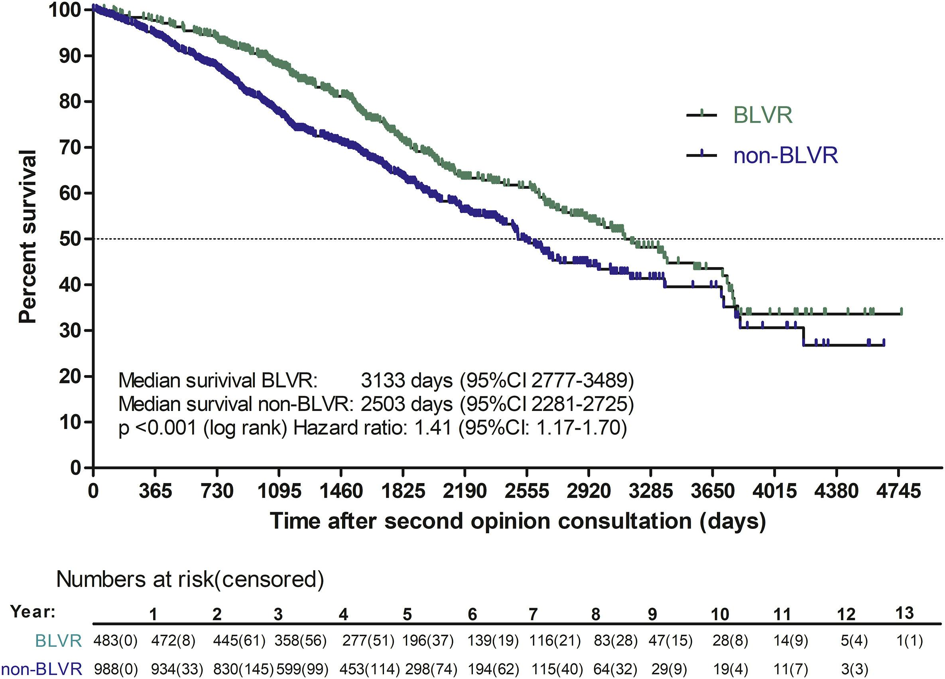
Signal - Survival in COPD Patients Treated with BLVR
Single-center, non-randomized, retrospective analysis of 1,471 patients evaluated for BLVR treatment over a 13-year period at University Medical Center Groningen (Netherlands)
483 patients underwent BLVR (73% EBV, 27% Coils)
Independent predictor of survival when adjusted for other survival-influencing factors like age, gender, or disease severity.
Kaplan-Meier plot of survival of patients who underwent BLVR treatment and who did not. BLVR: patients who underwent a bronchoscopic lung volume reduction treatment. Non-BLVR: patients who did not undergo a bronchoscopic lung volume reduction treatment. 95%CI: 95% confidence interval.
Hartman JE et al. Respir Med. 2022 May;196:106825.

Slide 21
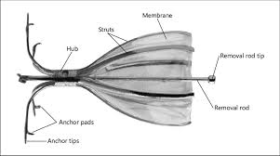




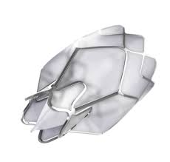
Filling the gap
Medical Management
Pulmonary Rehabilitation
Lung Volume Reduction Surgery
Lung Transplant
BLVR
Non Invasive
Minimally Invasive
Invasive

Slide 22
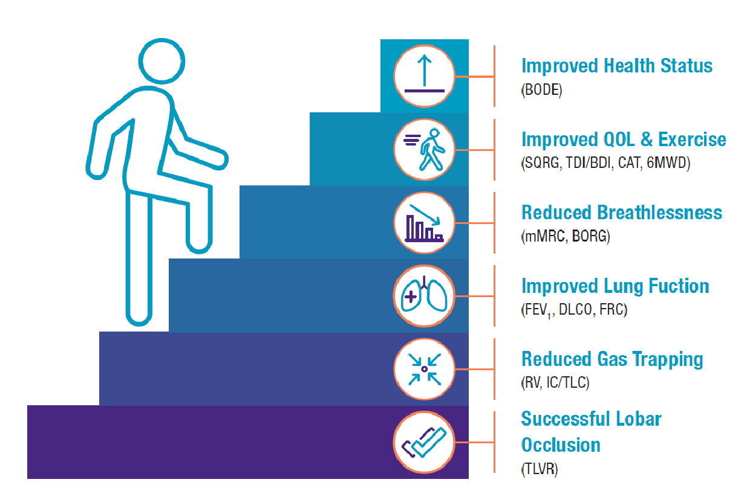
Summary of Intended Benefits for Patient
*
*
*
*
*
‡
D0543EN_A

Slide 23
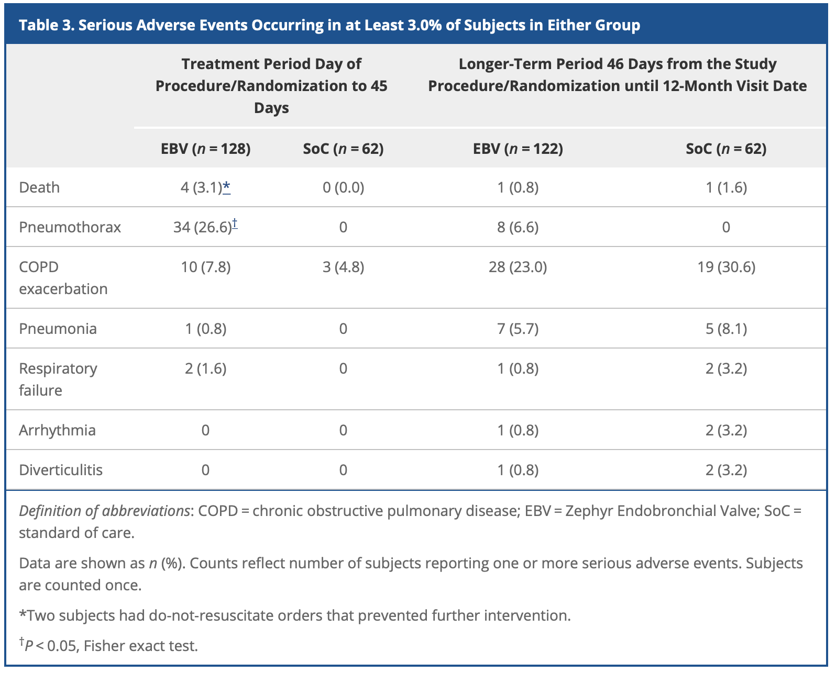
Liberate Study Adverse Reactions
Criner J et al. AJRCCM. 2018.

Slide 24
What is Collateral Ventilation?
  Collateral ventilation is airflow between lobes “through channels that bypass the normal airways”*
  Only lobes WITHOUT collateral ventilation should be treated with valves
Collateral Ventilation (CV+)
No Collateral Ventilation (CV-)

Slide 25
Sealants for Collateral Ventilation
A Controlled parallel group trial of 28 patients (14 in each group).
If fissure 80-95% - EPF instilled following confirmation of CV with CHARTIS with EBV inserted 1 month after.
EPF found to successfully reverse CV in severe COPD patients with a left oblique fissure that is 80%–95% complete.
Following EBV, outcomes similar to pts with complete fissures.
Conclusion: EPF therapy to reverse CV+ potentially increases the number of COPD patients suitable for BLVR with minimal adverse reactions.
EPF = Endoscopic Polymer Foam– Aeriseal®
Ing AJ et al. Respirology. 2022.

Slide 26
CONVERT Trial: Initial Results
Multicenter, single arm study
1⁰ Objective: Evaluate AF to convert a CV+ lung lobe
2⁰ Objective: Zephyr® EBV treatment in the CV- converted patients.
Study to enroll 140 subjects with Chartis® confirmed CV+ status.
Initial Results: 32 subjects (16M/16F)
  83% of pts completing the first stage have successfully converted and treated with Zephyr® EBV.
Initial Conclusions:
  AF can safely and effectively convert a CV+ lobe to having little to no CV.
  Emphysema patients with a defined fissure gap in the target lobe may have an option for BLVR with Zephyr EBV after closure of the fissure gap with AF.
AF=Aeriseal® Foam
Bezzi M et al. Eur Respir J. 2022.

Slide 27
The BLVR Procedure
Examples
Workup
Procedural Expectations

Slide 28
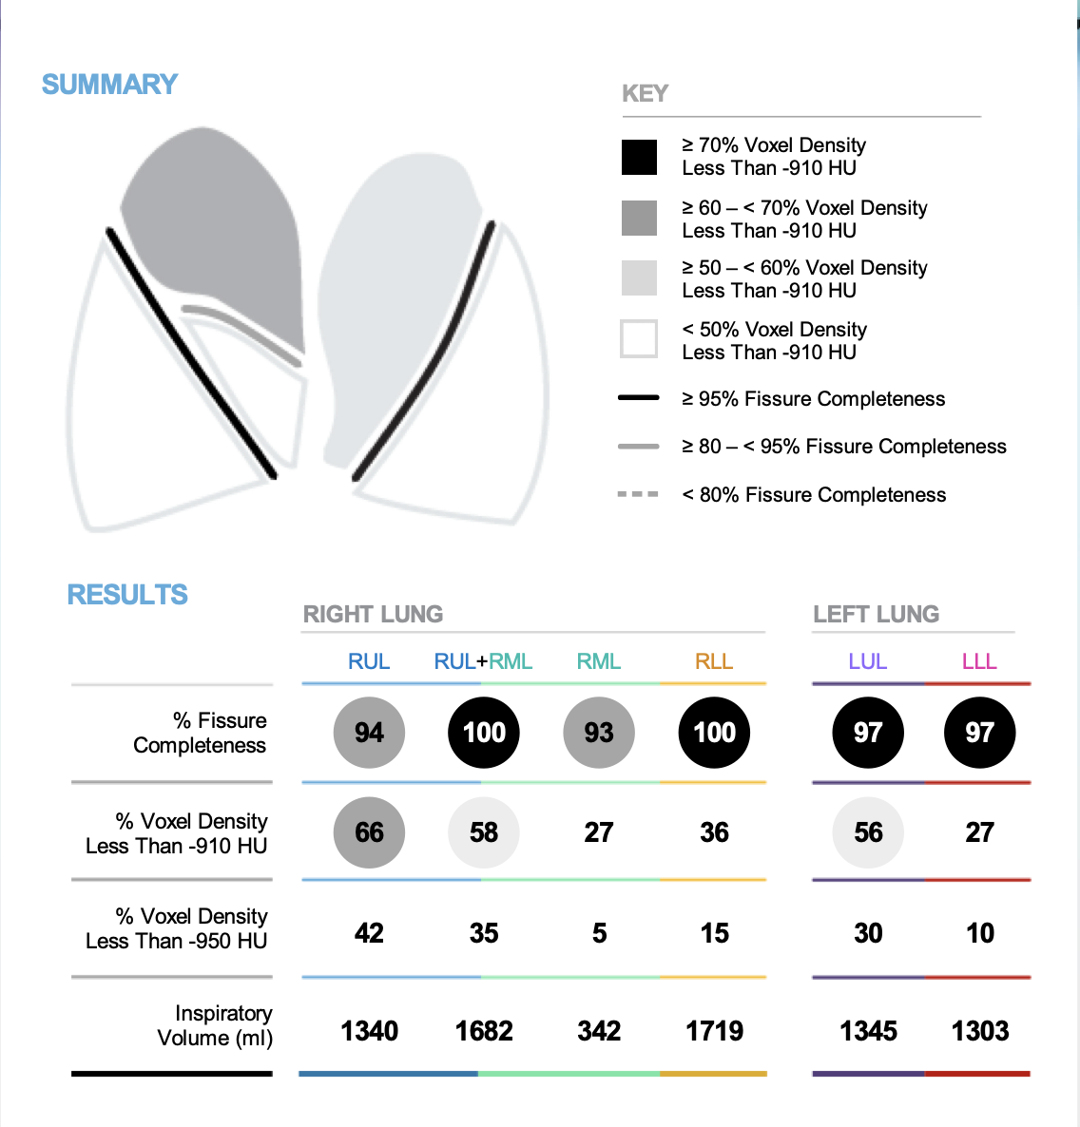
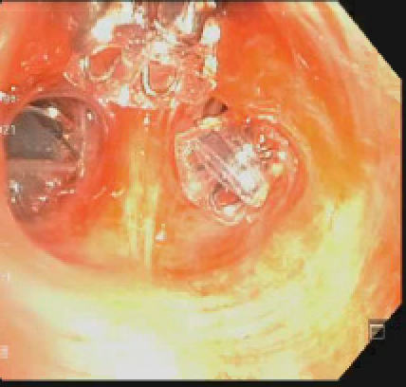
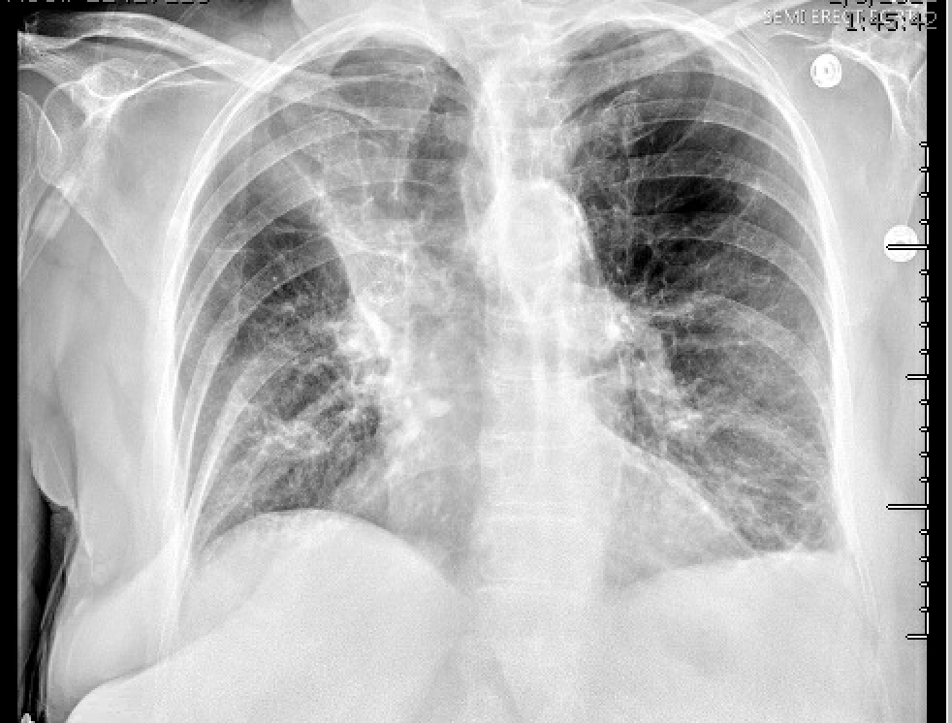
74F with HO Emphysema – S/p BLVR with Zephyr®
*Improved PFTs, 6MWD, Dyspnea

Slide 29
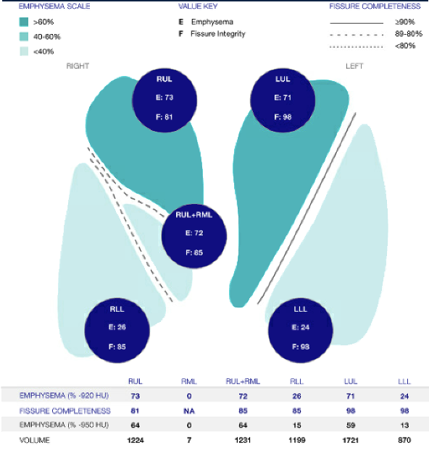
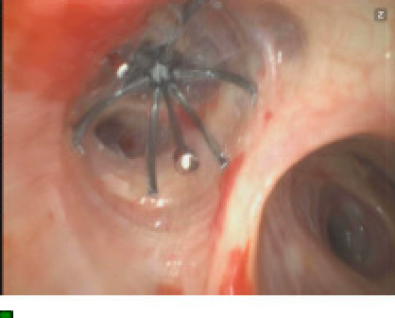
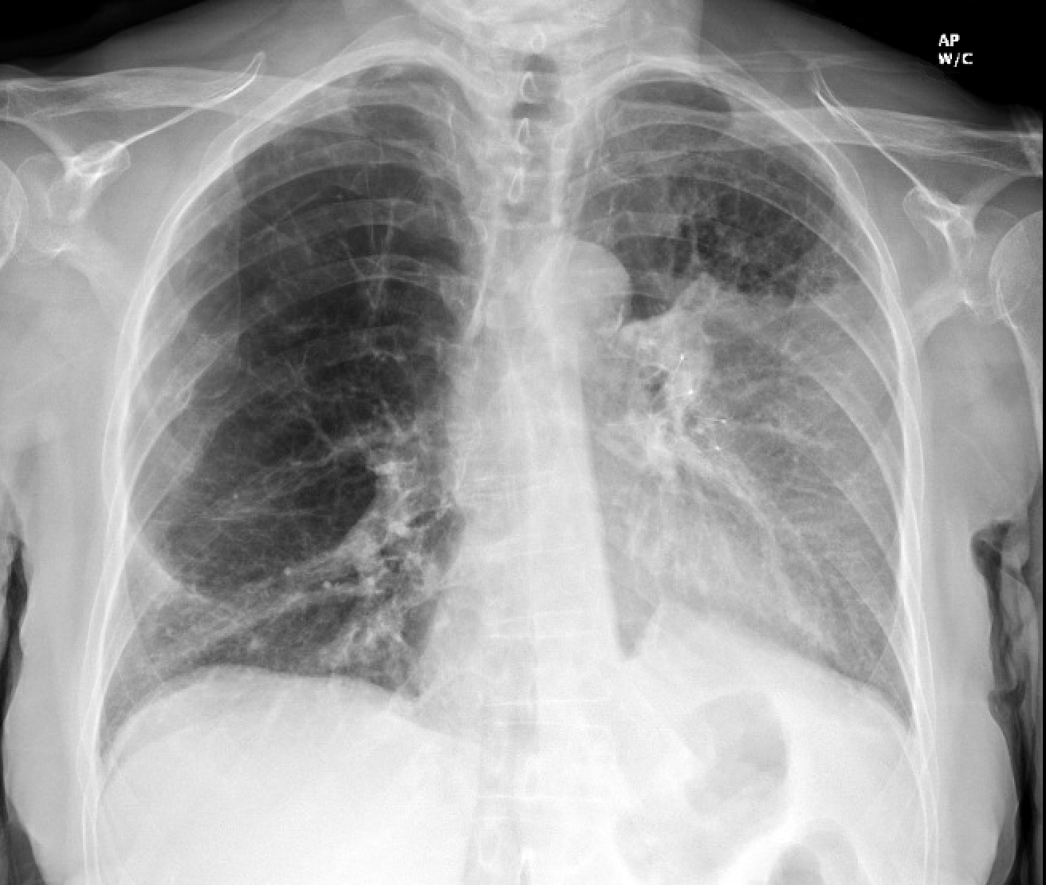
79F with HO Emphysema– s/p BLVR with SVS®

Slide 30
Typical Work Up for Valve Eligibility
Medical history
  Diagnosis of emphysema
  BMI < 35 kg/m²
  Stable with ≤ 20mg prednisone (or equivalent) daily
  Non-smoking
  Collect any available imaging and lung function studies
6MWD (100m–500m)
Pulmonary Function Tests (post-bronchodilator)
  Spirometry (FEV₁ 15–45% predicted)
  Body Plethysmography (RV ≥ 175%, TLC ≥ 100% for Heterogenous emphysema and RV ≥ 200% predicted, TLC ≥ 100% predicted for Homogeneous emphysema)
Imaging
  High Resolution CT (≤ 1.5mm slice thickness, TLC view)
  Evaluate QCT
  Perfusion Scan (Highly Recommended)
Arterial Blood Gas Levels collected on room air
  Rule out severe hypercapnia PaCO2 ≥50 mm Hg
  Rule out severe hypoxemia PaO2 ≤45 mm Hg
Echocardiogram
  Rule out congestive heart failure, LVEF <45%
  Rule out uncontrolled pulmonary hypertension, sPAP >45mm Hg

Slide 31
The Day of the Procedure at UChicago
Don’t eat anything after midnight
Check in on the 7th floor of the CCD (Sky Lobby) an hour before the schedule procedure.
Come down to the 5th floor Procedural prep area
  Get an IV
  Meet the anesthesia team
  Sign consent forms
Come to the Bronchoscopy Lab
General Anesthesia
Procedure takes about 1 hour
Go back to the Post procedure area and get a CXR.
If valves are placed – stay for 3 nights (monitor for pneumothorax)
If valves are not placed – able to go home.

Slide 32
Post-Valve Placement Recommendations
Minimum of 3 hospital nights post-procedure for observation for pneumothorax
  Chest tube kit should be kept by bedside
  Chest tube should be able to be placed 24/7 within 15-30 minutes
Possibly longer stay based on physician’s discretion and if there is persistent chest discomfort or pain on the treated side
Remain Active post procedure (Walk around the hospital)
US-EN-574 v1

Slide 33
Day of Discharge
Obtain CXR (PA & LATERAL) in X-ray department, have physician look at the CXR for pneumothorax before discharging the patient
Go over the discharge medications
Give patient ID card and emergency Info (stating # of Valves inserted & in which Treated Lobe with phone # of Implant Physician)
Inform Patient to call if he/she has any increased symptoms of shortness of breath, cough, purulent sputum, fever, chills or hemoptysis
Inform patient to go to the nearest ER if symptoms are severe or persist
Schedule outpatient clinic visit for Day #45 and CXR (We do PFT and CT)
US-EN-574 v1

Slide 34
Patient-Reported Benefits
  Reduced breathlessness across multiple measures
  Greater ability to do activities such as get washed, do household chores and go for walks
  Fewer limitations in their ability to do activities or return to work
  Feeling more energetic
  More confidence leaving their homes despite their condition

Slide 35
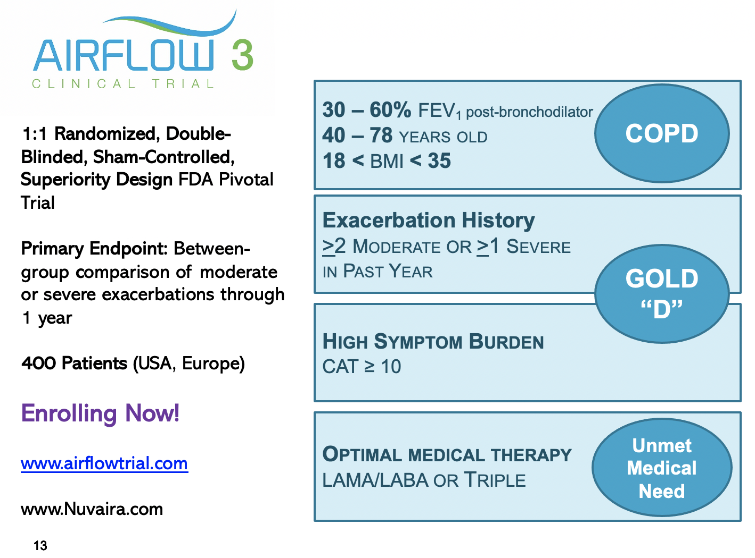
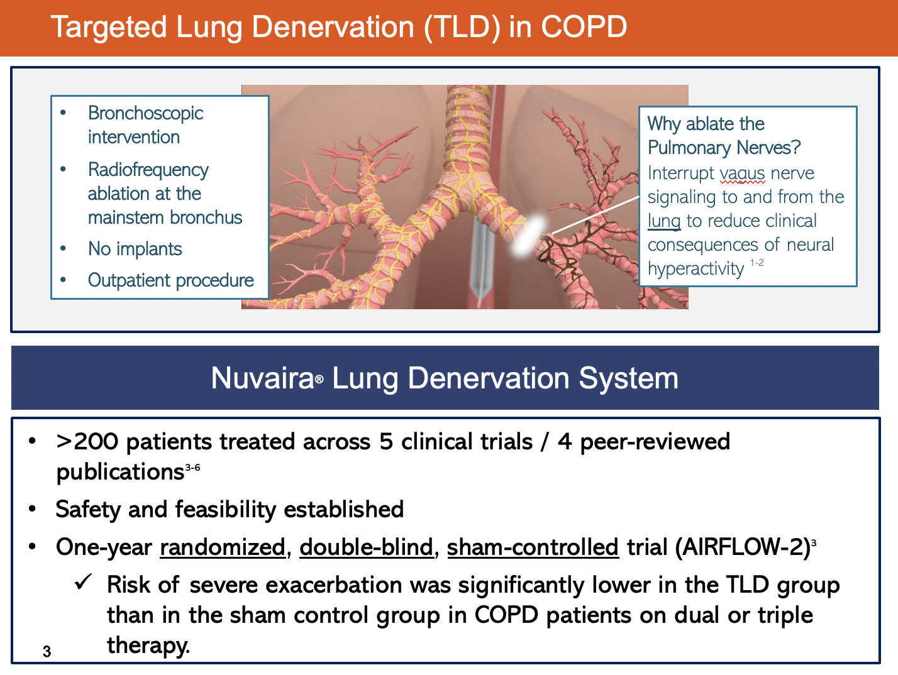
A Couple of Mentions - Airflow 3 – TLD

Slide 36
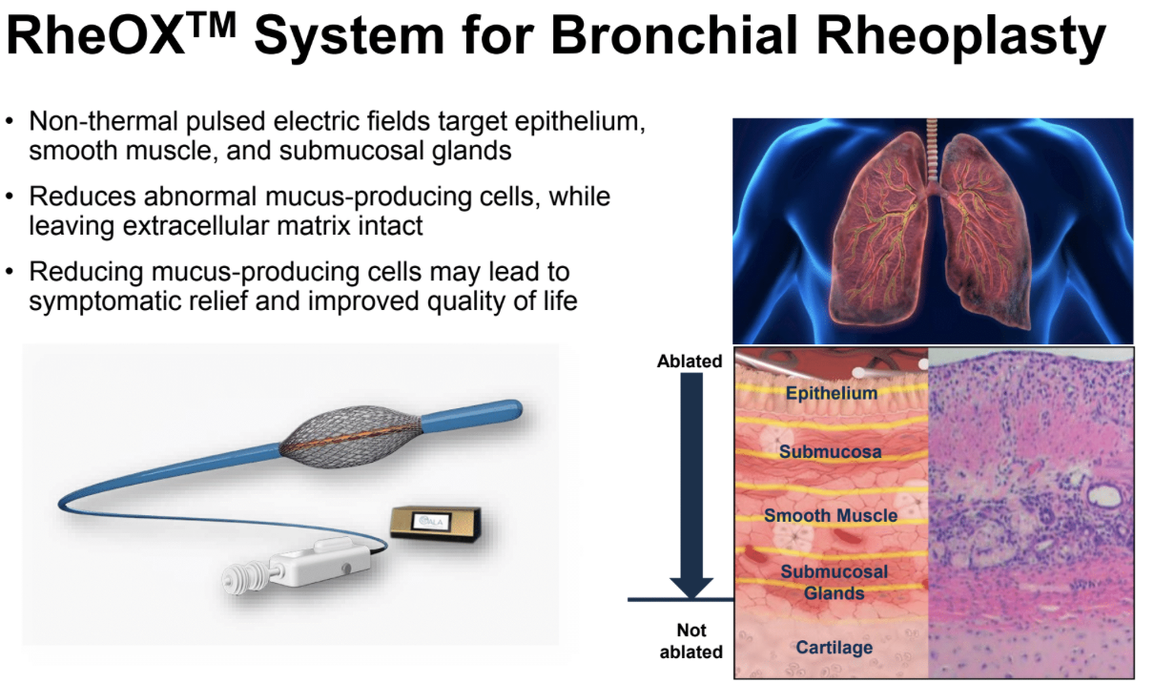
Bronchial Rheoplasty Study

Slide 37
Conclusions
Advanced Treatments are available for patients with severe emphysema who are symptomatic despite maximal medical and rehab therapies.
BLVR with EBV has been demonstrated to be safe and effective for patients with Emphysema who qualify – improving Lung function, 6MWD, QOL
  Incremental benefit as add-on treatment
Other advanced treatments are available or being investigated for patients with COPD.
  LVRS
  Transplant
  Other investigations options
    Targeted lung deneveration
    Bronchial Rheoplasty

Slide 38
THANK YOU! Questions/Concerns/Comments?
IP Team - University of Chicago
  Kyle Hogarth, MD
  Tim Murgu, MD
  Ajay Wagh, MD
  IP Fellow – Shreya Podder MD
  Kathy Conner, RN
  Tanya Casey

