Slide 1


Breathe better:
New medications for COPD
Hannah Ayers, PharmD
PGY2 Ambulatory Care Pharmacy Resident
University of Illinois Chicago
Retzky College of Pharmacy

Slide 2
Table of contents
01
02
03
Summarize current status of inhaler pricing in Illinois
Discuss how to best use current inhaler therapy
Describe potential benefits and challenges of new COPD medications

Slide 3


IL Public Act 103-0951
Notes:
Inhaler prices have increased since 2008 due to government regulations prohibiting the use of hydrocarbon-based propellants in inhaler devices². This prohibition, aimed at reducing environmental harm, forced manufacturers to redesign inhalers using alternative propellants like hydrofluoroalkane (HFA), significantly increasing production costs
Goal: lower costs for patients, improved medication adherence, and public health benefits are significant advantages

Slide 4
August 9, 2024
Prescription Inhalers: monthly price capped at $25 including rescue or maintenance inhalers
  National effort to decrease cost of essential medications
  Manufacturers must adapt pricing models
Implementation by January 2026
Notes:
Amends the Illinois Insurance Code. Provides that a health plan must limit the total amount that a covered person is required to pay for a covered prescription inhaler at an amount not to exceed $25 per 30-day.
Coverage for prescription inhalers shall not be subject to any deductible.
Effective January 1, 2025 and must be enacted by insurance by Jan 2026
For patients with commercial insurance, so no medicare or Medicaid there are also manufacturers offering set prices for inhalers

Slide 5
Manufacturer Monthly Caps
Maximum price for out-of-pocket cost of $35
AstraZeneca
Boehringer Ingelheim
GSK – January 2025
Notes:
What do we mean by monthly cap – manufacturers are guaranteeing patients only pay a certain amount out-of-pocket for patients with commercial insurance or no insurance

Slide 6
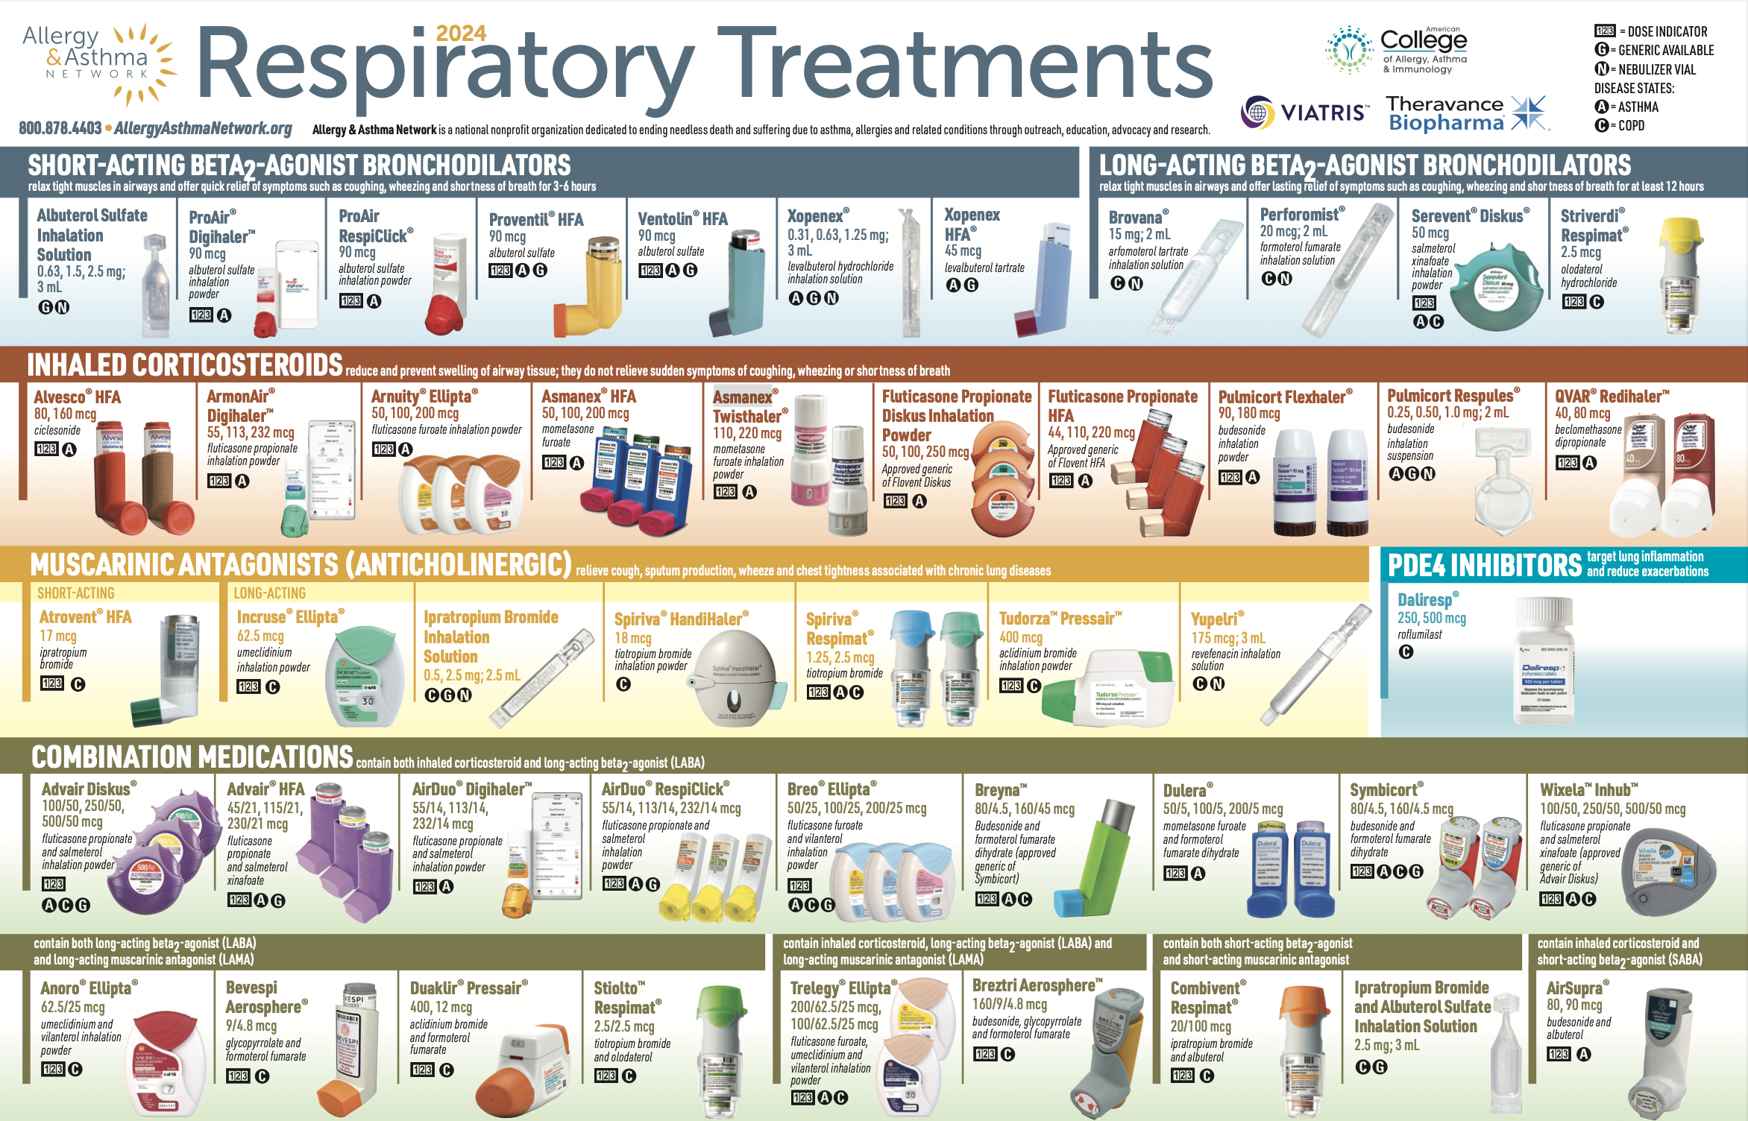
Notes:
Breztri and Airsupra have a $0 savings card available for patients with commercial insurance.
https://community.aafa.org/blog/aafa-leads-the-way-to-lower-costs-of-asthma-inhalers

Slide 7

Optimize current therapy

Slide 8
Preventive care
Abstain from smoking and vaping use
Pulmonary rehabilitation
Vaccinations
  Influenza – annually
  RSV – 1 dose for >60 years
  Pneumonia – 1 or 2 dose series depending on product, 1 additional dose >65 years
  Tdap – 1 dose every 10 years
  Zoster – 2 dose series >50 years
  COVID – 1 or 2 dose series of 2023-2024 Formula (depends on manufacturer)
Notes:
Pneumonia schedule: https://www.cdc.gov/pneumococcal/downloads/vaccine-timing-adults-jobaid.pdf?CDC_AAref_Val=https://www.cdc.gov/vaccines/vpd/pneumo/downloads/pneumo-vaccine-timing.pdf

Slide 9
What are your best tips?
Examples
What kind of breath is required?
How many actuations are in the inhaler product?
Where should the inhaler be stored?
Do you need to rinse out mouth?

Slide 10
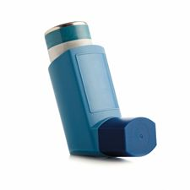
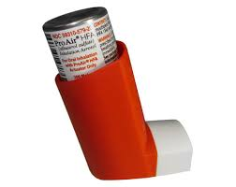
What are your best tips?

Slide 11
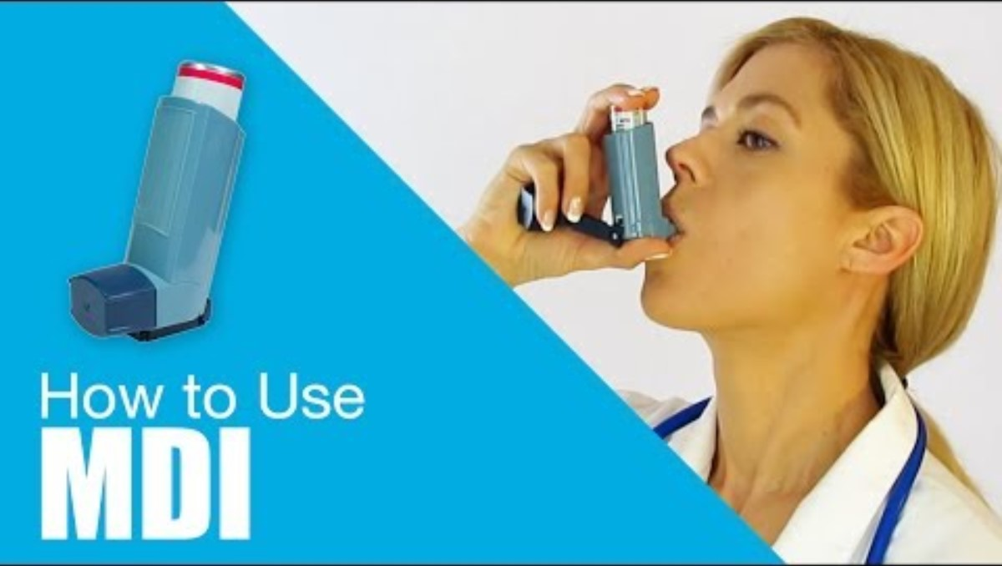
Metered Dose Inhaler

Slide 12
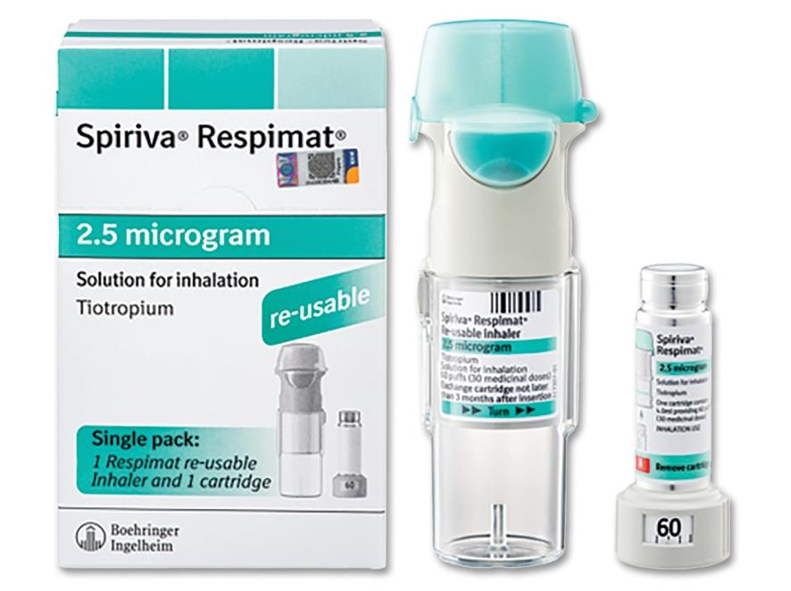
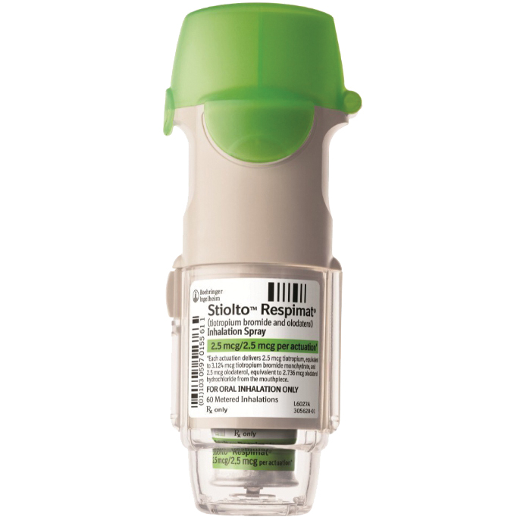
What are your best tips?

Slide 13
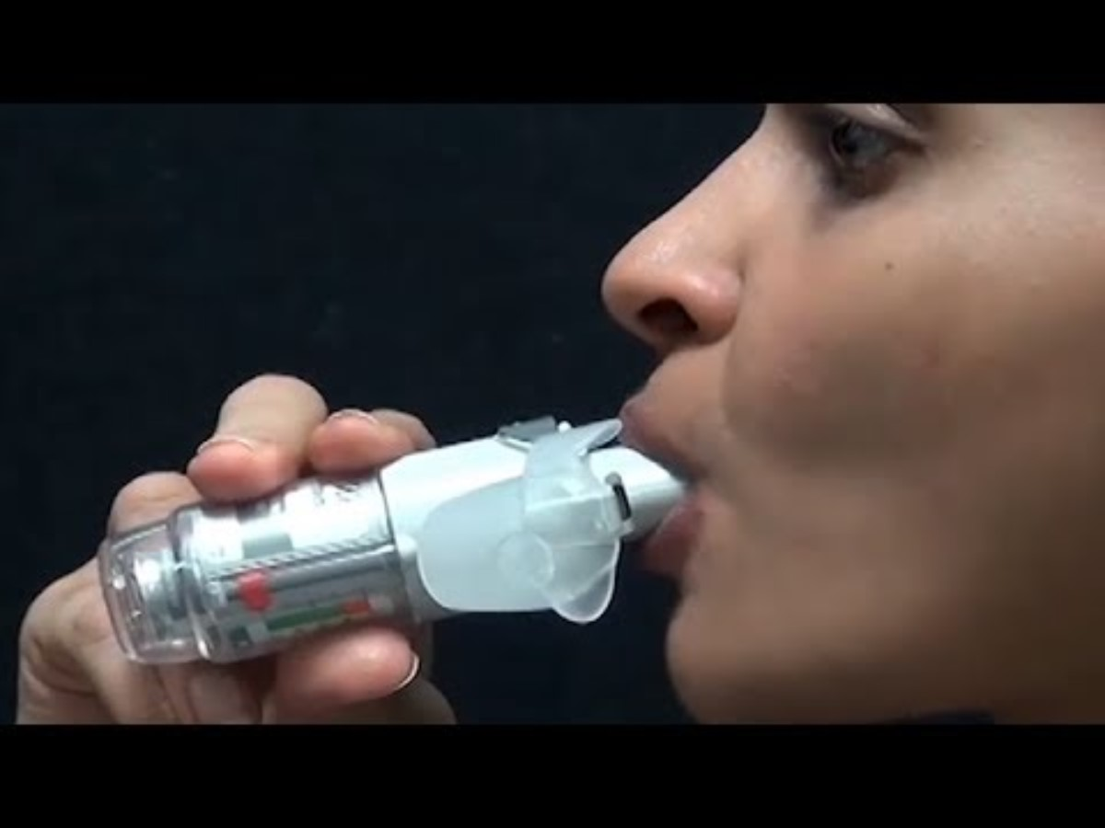
Respimat

Slide 14
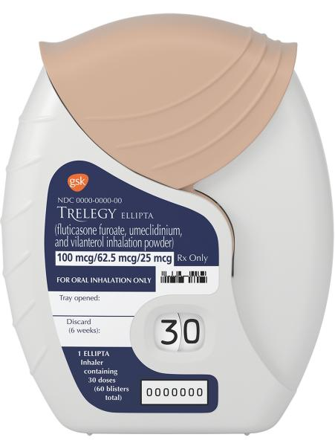
What are your best tips?

Slide 15
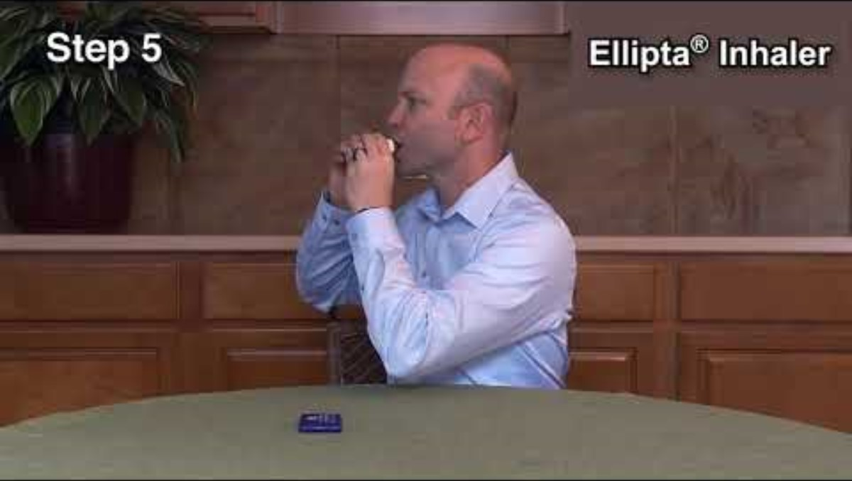
Ellipta

Slide 16
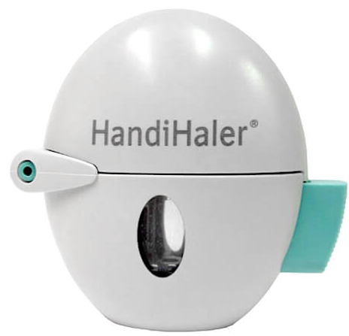
What are your best tips?

Slide 17
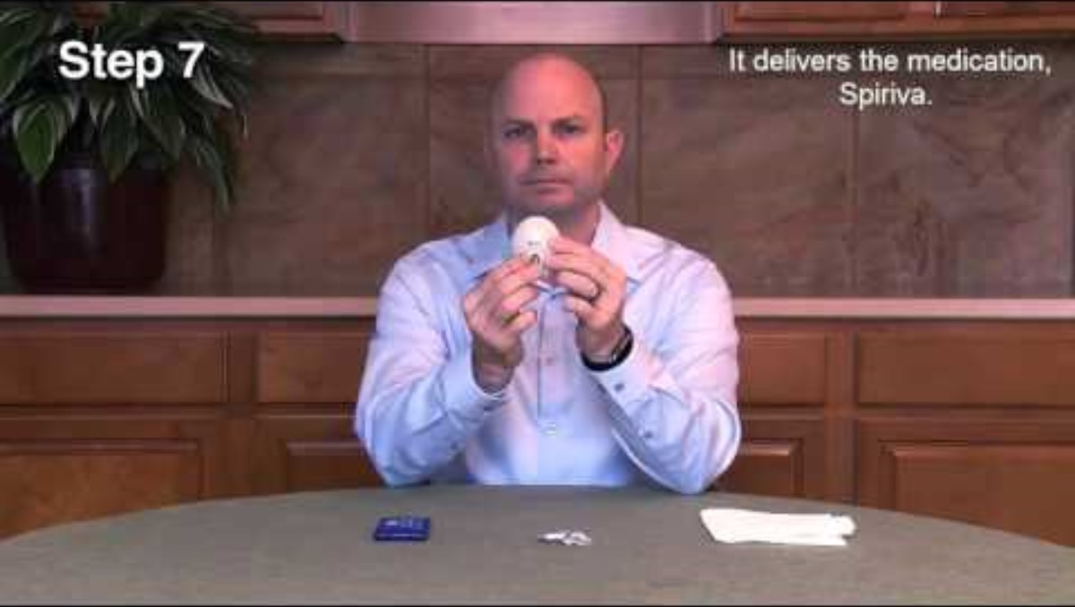
Diskus

Slide 18

New COPD therapies

Slide 19
Goals of medications
MORE prevention
Keep COPD from worsening
Decrease risk of hospitalizations
LESS symptoms
Stop cough, shortness of breath, sputum production
Increase ability to be active
Improve quality of life

Slide 20
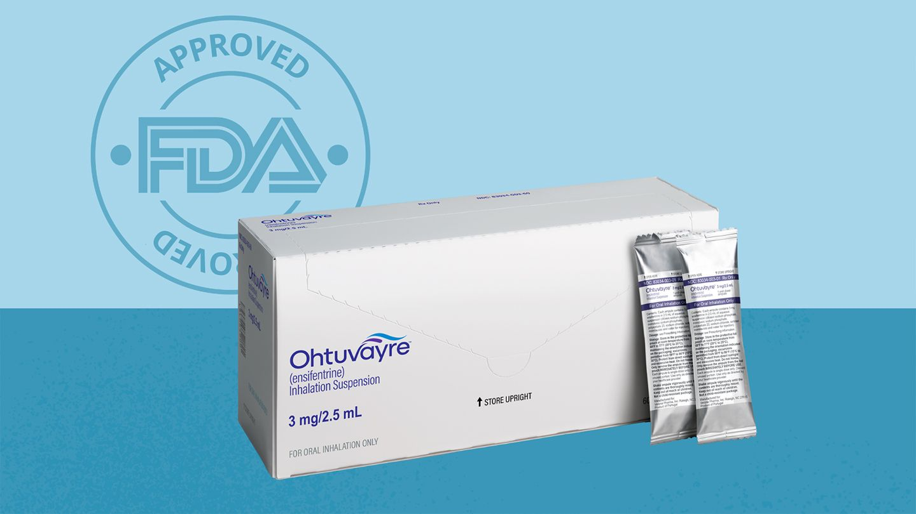
Ohtuvayre (Ensifentrine)
Approved for "maintenance treatment of chronic obstructive pulmonary disease (COPD) in adult patients"
Notes:
In the guidelines, it is recommended to consider adding ensifentrine to your current inhaler regimen if you are having shortness of breath
Ensifentrine signficantly improves lung function (A), dyspnea (A), and health status (B)

Slide 21
Would ensifentrine be right for me?
Yes
Have shortness of breath
Currently using inhalers for COPD
Mild to moderate COPD
No
Recent worsening of symptoms
Currently using roflumilast (Daliresp)
Notes:
Patients most likely to benefit
Patients can expect to have less shortness of breath with this medication, need to continue current therapy

Slide 22
Things to consider
Inhalation solution
Coverage
Specialty pharmacy
Twice daily dosing
Need a new nebulizer if current > 3 years old
Medicare part B
"Bridge Program" through manufacturer
Patient assistance program
Dispense nebulizer and medication
Provide instructions for how to use medication
Schedule and ship refills
Notes:
Twice daily nebs
Verona Pathway Plus may be able to help with starting treatment if there is a coverage delay with your insurance
If you are eligible and have commercial insurance, you may pay as little as $0 per month
If you do not have insurance, are underinsured, or in a situation in which Ohtuvayre is not covered by your insurance plan, Verona Pathway Plus can provide appropriate financial assistance options.

Slide 23
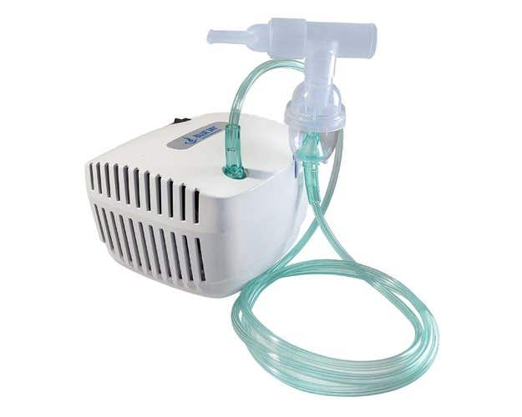
Notes:
Pretty safe drug, no major side effects were noted.
Patients symptoms and lung function improved within 12 weeks

Slide 24
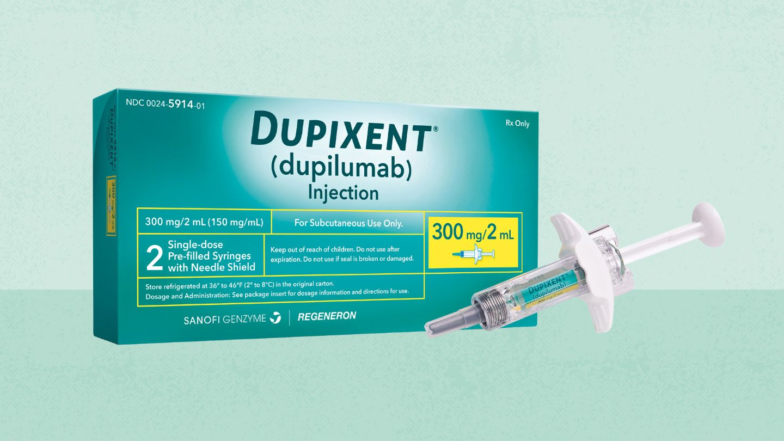
Dupixent (dupilumab)
Approved for "as an add-on maintenance treatment of adult patients with inadequately
controlled chronic obstructive pulmonary disease (COPD) and an
eosinophilic phenotype"
Notes:
In patients with moderate to severe COPD with a history of exacerbations, chronic bronchitis and signs of an inflammatory response--> Dupilumab reduces exacerbations, improves lung function and quality of life

Slide 25
Would dupilumab be right for me?
Yes
Currently using multiple inhaled medications for COPD
Have shortness of breath, cough, or wheezing
Elevated 'inflammatory markers'
Recent worsening of symptoms
Concurrent conditions: atopic dermatitis, asthma, chronic rhinosinusitis with nasal polyposis (CRSwNP), eosinophilic esophagitis (EoE), prurigo nodularis and chronic spontaneous urticaria
No
Bronchospasms
Self-injections
Notes:
Patients most likely to benefit
No benefit for acute bronchospasms
Expect less hospitalizations or steroid use, continue current therapy

Slide 26
Things to consider
Injection
Coverage
Specialty pharmacy
Every 2 weeks
Inject under the skin
Can be administered at home
Dupixent MyWay copay assistance up to $13,000 per year
Patient assistance program
Dispense medication
Provide instructions for how to use medication
Schedule and ship refills
Notes:
79% of Medicare Part D patients can expect to pay between $0-$100 per month for DUPIXENT
Able to check insurance coverage status on the Dupixent website

Slide 27
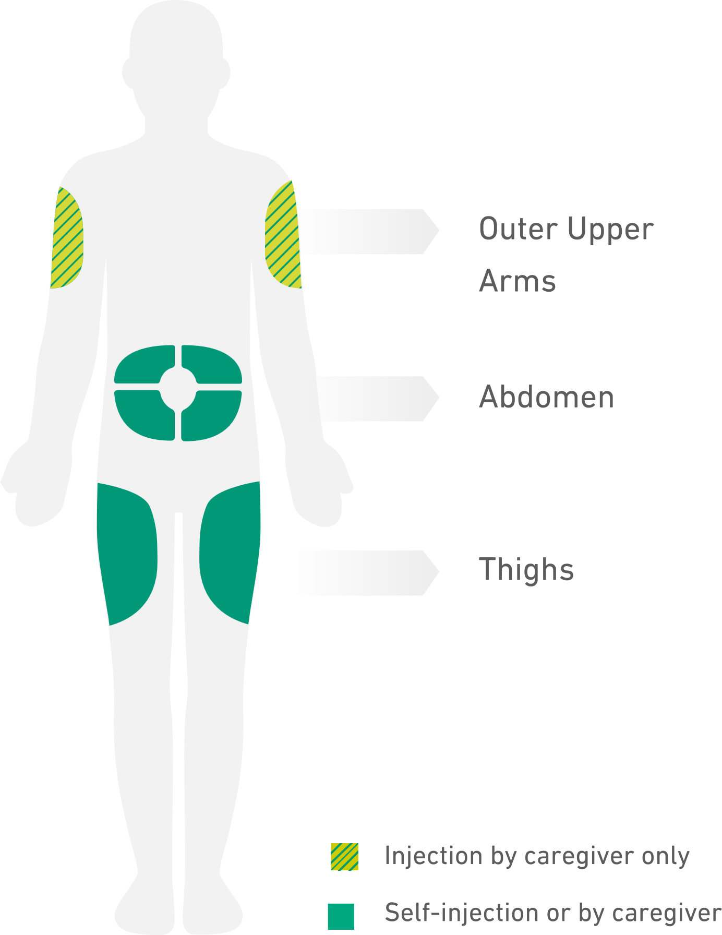
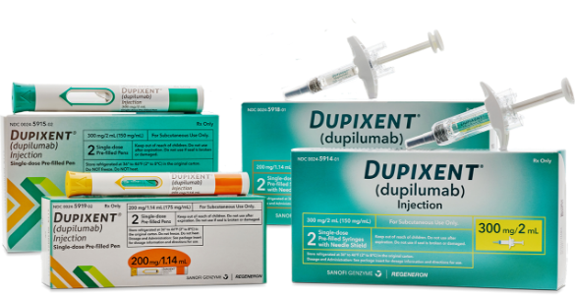
Notes:
Side effects include an upper respiratory infection, injection site pain, hypersensitivity (rash, swelling) which is why you undergo training prior to injecting
Can be administered at home or at your doctor’s office

Slide 28
Summary
Inhaler pricing
Current regimen
New therapies
Optimize preventive measures including smoking/vaping cessation, vaccination adherence
Proper inhaler technique is essential
Ohtuvayre (ensifentrine) can help to decrease shortness of breath
Dupixent (dupilumab) can help to decrease hospitalizations and steroid use for chronic bronchitis type
Rescue and maintenance inhalers will cost $25/month max by January 2026

Slide 29
Questions?
Hannah Ayers
Hayers3@uic.edu

