Slide 1
Living with COPD: The Importance of Vaccinations

Slide 2
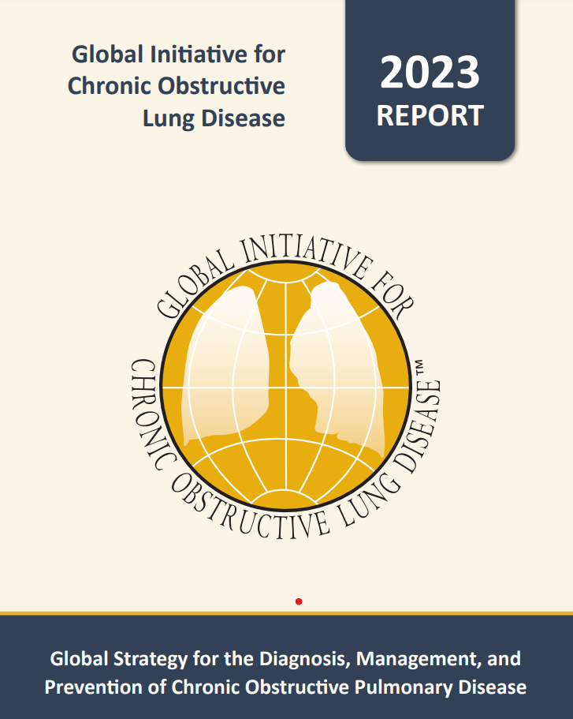

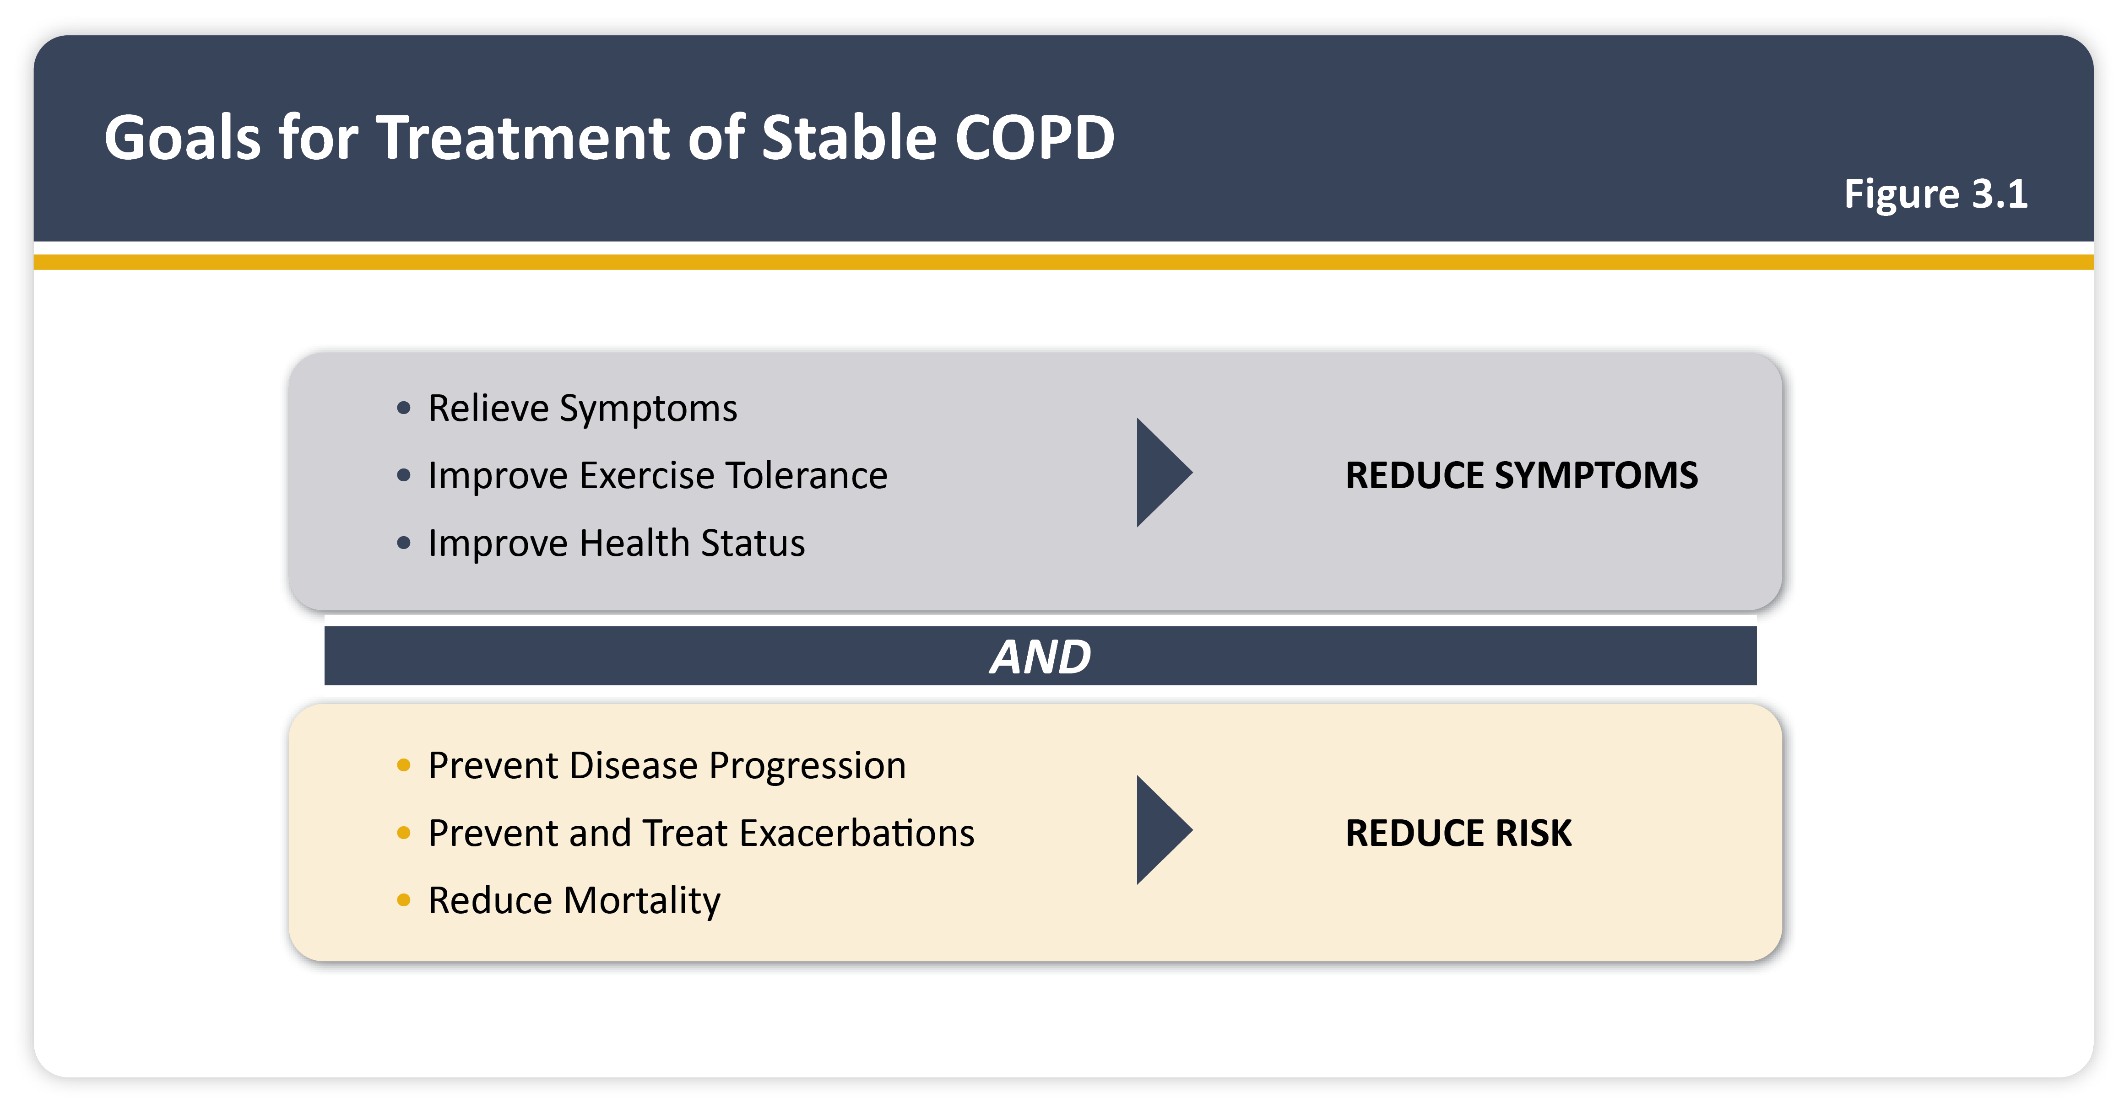
Goals for treatment of stable COPD
Teaching
Slide Set

Slide 3
Definition of a COPD Exacerbation
“An acute worsening of respiratory symptoms that results in additional/change in therapy.”
  dyspnea, cough and/or sputum beyond day-to-day variability
Classification of exacerbations:
  Mild: treated with short-acting bronchodilators (SABD) only
  Moderate: treated with SABD plus antibiotics and/or oral corticosteroids
  Severe: patient requires hospitalization or visit to the ER or acute respiratory failure

Slide 4
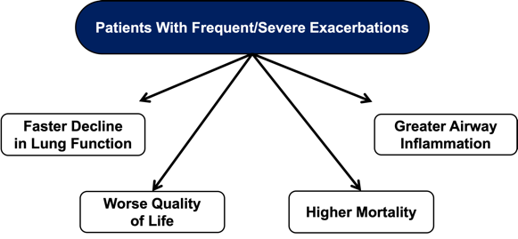
COPD Exacerbations
As of 2021, ~ 14.3 million US adults had COPD
Account for ~ 1.5 million ED visits
  726, 000 hospitalizations
  119, 000 deaths in 2000
http://www.goldcopd.com, 2009 Update
Mannino DM, et al. MMWR Surv Sum 2002; 51: 1
Seemungal TAR. AJRCCM 1998; 157: 1418

Slide 5
COPD Exacerbation Triggers
Infection
  Many are viral:
    influenza, parainfluenza, coronavirus, rhinovirus
  Role of bacteria is controversial:
    H. influenza, S. pneumoniae, M.catarrhalis
Air pollution
Ambient temperature
Cigarette smoking
Aspiration
Unclear in one-third of cases
Vitamin D deficiency
  Has immunomodulatory properties

Slide 6
Recommended Vaccines For Patients with COPD
Pneumonia Vaccine
Influenza Vaccine
Updated COVID Vaccine
RSV Vaccine

Slide 7

Pneumococcal Vaccine

Slide 8
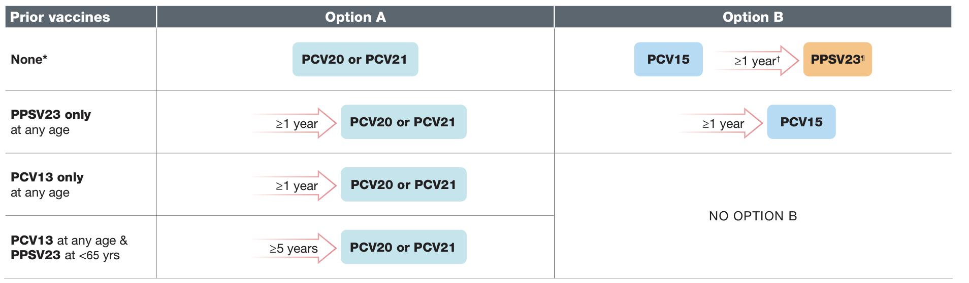
Pneumonia Vaccine
Reduces the risk of invasive pneumococcal disease
CDC Recommendations:
  All adults > 50 years old
  Adults greater than 65 who were previously vaccinated with PCV 13 and PPSV23
cdc.gov

Slide 9
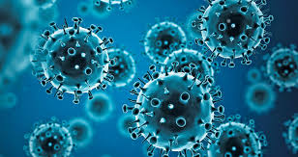
Influenza Vaccine

Slide 10
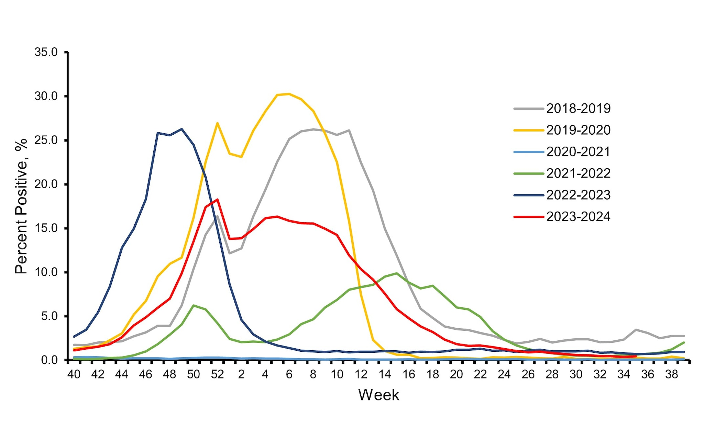
Influenza Trends
cdc.gov

Slide 11
Influenza Vaccine
During the 2019-2020 flu vaccination prevented:
  ~7 million influenza illnesses,
  ~3 million influenza-associated medical visits
  ~100,000 influenza-associated hospitalizations
  ~7,000 influenza-associated deaths in the United States.
Flu vaccine reduces the risk of needing to see a doctor for flu by 40% to 60%.
The CDC recommends:
  Everyone 6 months and over should get annual flu vaccine
cdc.gov

Slide 12

COVID-19 Vaccine

Slide 13
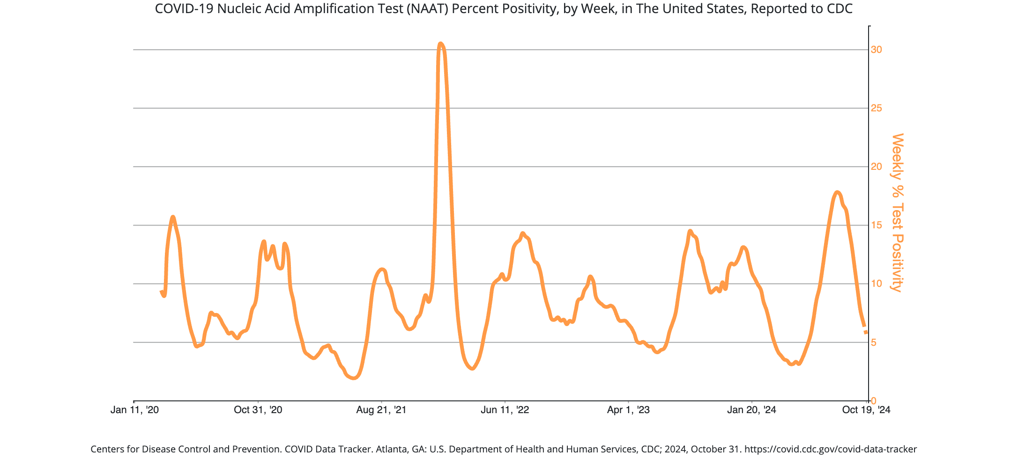
COVID Trends
cdc.gov

Slide 14
COVID-19 Vaccinations
mRNA vaccines
  Pfizer and Moderna
Protein subunit vaccines
  Novavax
CDC recommendations
  6 months and older should get 1 updated (2024-2025) vaccine
  65 years and older, previously vaccinated should get:
    2 doses of any 2024–2025 COVID-19 vaccine (i.e., Moderna, Novavax, or Pfizer-BioNTech) separated by 6 months
    Unvaccinated people who initiate vaccination with 2024–2025 Novavax:
    Should receive 2 doses of Novavax followed by a third dose of any COVID-19 vaccine 6 months later.
cdc.gov

Slide 15

RSV Vaccine

Slide 16
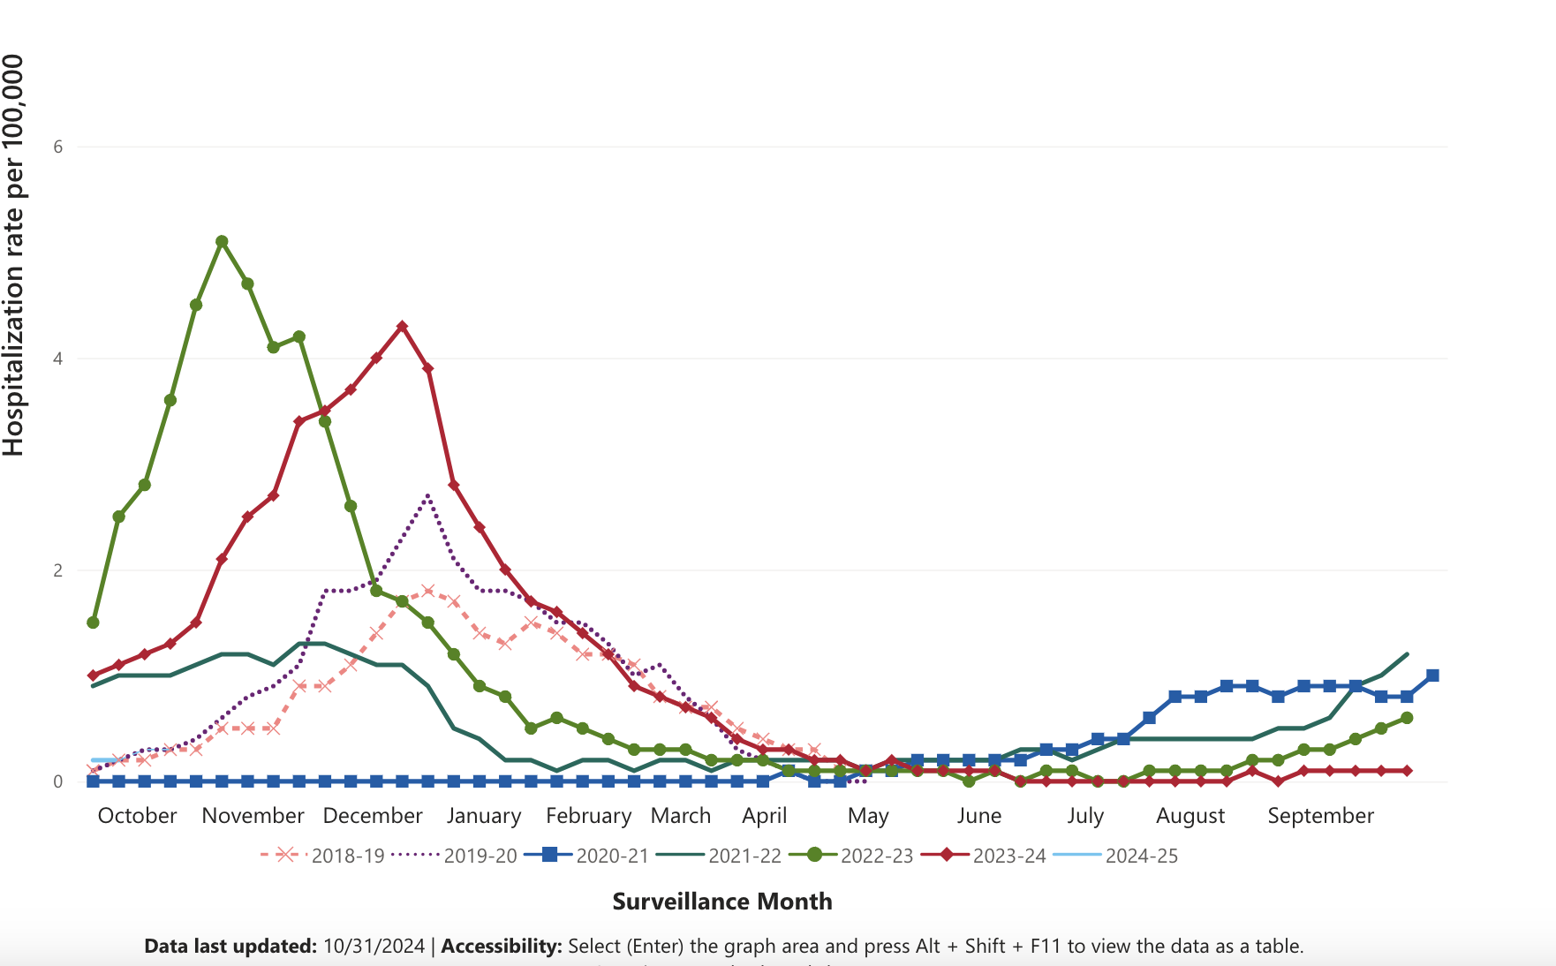
The Impact of RSV
cdc.gov

Slide 17
Respiratory Syncytial Virus Vaccine
Common respiratory virus that infects the nose, throat, and lungs and mimics the common cold.
Each year, ~ 100,000–160,000 adults ages 60 and older in the United States are hospitalized due to RSV.
CDC vaccine recommendations:
  Everyone ages 75 and older
  Adults ages 60–74 who are at increased risk of severe RSV illness
  You only need 1 vaccination currently
cdc.gov

Slide 18
Other Ways to Protect Yourself
Consider wearing masks
1
Contact your provider if you develop symptoms
2
Medications are available pneumonia, COVID and influenza
Remain on your medications unless otherwise directed by a physician
3

Slide 19
Are vaccines safe?
Yes

Slide 20
Can I get multiple vaccines at the same time?
Yes

Slide 21
When is the best time to get the vaccines?
Early-late Fall for Viruses
Any time for Pneumonia

